Slide 1
Continuous price and flow dynamics of Tradable mobility credits
Hongbo YE and Hai YANG
The Hong Kong University of Science and Technology
ISTTT20
17/07/2013
Notes:
Good morning. It is a great honor for me to present our research here in ISTTT. I am now a PhD candidate in the Hong Kong University of Science and Technology, and I finished this work with my supervisor Prof Hai Yang. Our topic is the continuous price and flow dynamics of tradable mobility credits.

Slide 2
Outline
Introduction
  Tradable mobility credits
  Day-to-day flow dynamics
Price and flow dynamics: assumptions & models
  Fixed demand & homogeneous travelers
Theoretical results
Numerical example
Conclusion
Notes:
Our presentation includes four parts. In the introduction we will give the background and motive of our research, including the literature reviews. In the second part, we assume the travel demand are fixed and travelers are homogeneous. The dynamic models will be introduced under three key assumptions. Also the analytical results will be given. The third part is the numerical example to elucidate the theoretical results. Finally is the conclusion.

Slide 3
Introduction
1.
Notes:
Now lets go to the introduction.

Slide 4
Why a Tradable Credit Scheme
Typical strategies dealing with traffic congestion
Desirable features | Congestion pricing | Road space rationing
Short-term and long-term effectiveness | ✓ | ✓/ ✗
Equity | ✗ | ✓/✗
Economic efficiency | ✓ | ✗
Governmental revenue-neutrality | ✗ | ✓
Tradable credit scheme
✓
✓
✓
✓
Notes:
Nowadays, traffic congestion has become a serious problem that impede everyone’s life. To alleviate congestion, one way is the demand management. There are widely-used methods, which are congestion pricing and road space rationing. Therefore, non of the current policies possess all the four desriable features, that’s why we propose the tradable credit scheme for congestion reduction. As I will show later, it posesess all the desirable features.

Slide 5
What is a Tradable Credit Scheme
Each participating agent receives a proportion of credits (on a periodic basis such as a month or a quarter)
  Equitable
Initial distribution for free
  Revenue-neutral incentives for mobility and environmental quality
Credit charging scheme
  Link-specific or cordon-based; distance or time-based; time-invariant or time-varying
Yang, H., Wang, X.L., 2011. Managing network mobility with tradable credits. Transportation Research Part B 45 (3), 580-594.
Notes:
Now let me introduce what is the tradable credit scheme proposed in our study. A tradable credit scheme compose three parts, an initial distribution scheme of free credits, a credit charging scheme, and a free credit trading market. The government initially distribute free credit schemes to all elegible receivers, for example, all tax payers. The distribution scheme can be O-D based or uniform, or through negotiation. These credits can be used to drive on any link of the network, but on different links, the credit charge rate are different. For example, consider this example network which consist only two links, there are ten people going from node 1 to 2. the government assign two credits to everyone, but if he uses link 1, he will be charged 3 links, and if use link 2, only 1 credit will be charged. To make all credits efficiently utilized, the credits are allowed trading among credit holders. The credit will expire after a short time period, for example, one month, or one week, so in this study, we assume no speculation of credits exists. And since there are a lot of credit holders, so no transaction cost is assumed, and the credit market is perfectly competitive. The government revenue neutral.

Slide 6
What is a Tradable Credit Scheme
A policy target in terms of fix-quantity travel credits can be easily achieved.
  Example: Distance-based credit charge for achieving control of total veh-km traveled on the network
The equilibrium price of credits is determined by the market through free trading.
  Market driven
  Credit: from the higher income groups to the lower Money: from the wealthy to the less
  Enhance income distribution or financial transfer confined only to within the predefined group of travelers
Notes:
Now let me introduce what is the tradable credit scheme proposed in our study. A tradable credit scheme compose three parts, an initial distribution scheme of free credits, a credit charging scheme, and a free credit trading market. The government initially distribute free credit schemes to all elegible receivers, for example, all tax payers. The distribution scheme can be O-D based or uniform, or through negotiation. These credits can be used to drive on any link of the network, but on different links, the credit charge rate are different. For example, consider this example network which consist only two links, there are ten people going from node 1 to 2. the government assign two credits to everyone, but if he uses link 1, he will be charged 3 links, and if use link 2, only 1 credit will be charged. To make all credits efficiently utilized, the credits are allowed trading among credit holders. The credit will expire after a short time period, for example, one month, or one week, so in this study, we assume no speculation of credits exists. And since there are a lot of credit holders, so no transaction cost is assumed, and the credit market is perfectly competitive. The government revenue neutral.

Slide 7
Mathematical Model of Traffic Equilibrium under Tradable Travel Credit Schemes
Equivalent model formulation:
First-order optimality conditions:
subject to:

Slide 8
Traffic Equilibrium and Market Equilibrium with Tradable Credits: An Example

Slide 9
Traffic Equilibrium and Market Equilibrium with Tradable Credits: An Example
For a given credit scheme, a unique equilibrium flow pattern exists; the equilibrium credit price is unique subject only to very mild assumptions.
A properly designed tradable credit scheme can emulate a congestion pricing system and support various desirable traffic flow optima:
  Social optimum
  Capacity-constrained traffic flow pattern
  Pareto-improving and revenue-neutral

Slide 10
Extensions
Transaction cost
Nie, Y., 2012. Transaction costs and tradable mobility credits. Transportation Research Part B 46 (1), 189-203.
User heterogeneity
Wang, X., Yang, H., Zhu, D., Li, C., 2012. Tradable travel credits for congestion management with heterogeneous users. Transportation Research Part E 48 (2), 426-437.
Zhu, D., Yang, H., Li, C., Wang, X., 2013. Properties of the multiclass traffic network equilibria under a tradable credit scheme. Transportation Science (revised version under review).
Managing parking
Zhang, X., Yang, H., Huang, H.J., 2011. Improving travel efficiency by parking permits distribution and trading. Transportation Research Part B 45 (7), 1018-1034.

Slide 11
Extensions
Managing bottleneck congestion and mode choice
Nie, Y., Yin, Y., 2013. Managing rush hour travel choices with tradable credit scheme. Transportation Research Part B 50, 1-19.
Tian. L.J., Yang, H., Huang H.J., 2013. Tradable credit schemes for managing bottleneck congestion and modal split with heterogeneous users. Transportation Research Part E 54, 1–13.
Xiao, F., Qian, Z., Zhang, H.M., 2013. Managing bottleneck congestion with tradable credits. Transportation Research Part B (in press).
Implementation issue under limited information
Wang, X., Yang, H., 2012. Bisection-based trial-and error implementation of marginal cost pricing and tradable credit scheme. Transportation Research Part B 46 (9), 1085-1096.
Wang, X., Yang, H., Han, D., Liu, W., 2013. Trial-and-error method for optimal tradable credit schemes: The network case. Journal of Advanced Transportation (in press).

Slide 12
Extensions
Incorporation of income effects
Wu, D., Yin, Y., Lawphongpanich, S., Yang, H., 2012. Design of more equitable congestion pricing and tradable credit schemes for multimodal transportation networks. Transportation Research Part B 46 (9), 1273-1287.
Mixed equilibrium behaviors
He, F., Yin, Y., Shirmohammadi, N., Nie, Y., 2013. Tradable credit schemes on networks with mixed equilibrium behaviors. Transportation Research Part B (submitted).
Design issue
Wang, G., Gao, Z., Xu, M., Sun, H., 2013. Models and a relaxation algorithm for continuous network design problem with a tradable credit scheme and equity constraints. Computers and Operations Research (in press)

Slide 13
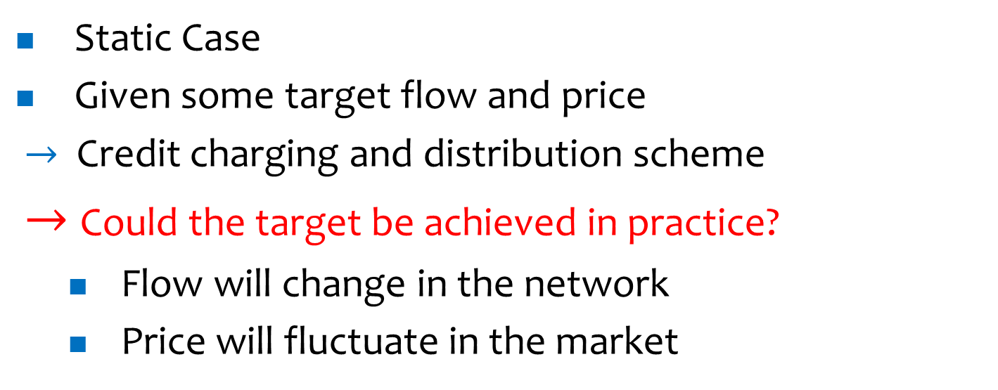
Our Motive
Static Case
Given some target flow and price
$→$ Credit charging and distribution scheme
$→$ Could the target be achieved in practice?
  Flow will change in the network
  Price will fluctuate in the market

Slide 14
Day-to-day Traffic Flow Dynamics
Deterministic Process
Stochastic Process
  Cascetta (1989)
  Watling and Hazelton (2003)
  Parry and Hazelton (2013)
Smith (1984) Friesz et al (1994) Zhang and Nagurney (1996) Cho and Hwang (2005) Yang and Zhang (2009) | He et al (2010) Smith and Mounce (2011) Han and Du (2012) He and Liu (2012)
Continuous-time / Discrete-time
Link-based / Path-based

Slide 15
Day-to-day Traffic Flow Dynamics
Travelers’ perception on travel time and learning behavior
  Horowitz (1984)
  Cantarella and Cascetta (1995)
  Watling (1999)
  Bie and Lo (2010)

Slide 16
Model Description
2.

Slide 17
Basic Consideration
How the traffic flow and credit price will impact each other and evolve together.
Travelers’ learning behavior of route choice based on their perceived path travel cost and credit price.
Price adjustment with the fluctuation of credit demand and supply.

Slide 18
Notations

Slide 19
Notations

Slide 20
Path Choice
Travelers’ path choice. Probabilities for travelers choosing paths depend on the perceived travel costs on all the paths.

Slide 21
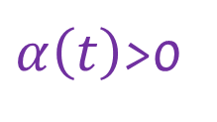
Learning Behavior
Travelers’ learning behavior. Travelers update their perception according to the revealed traffic condition.
$α\left(t\right)$>0
Real travel time
Perception

Slide 22
Price Evolution
Credit price evolution. The changing of credit price depends only on the current price and excess credit demand.
Excess credit demand is the difference between the current credit consumption rate and the average credits per unit time available during the rest of the period.
Price Evolution Function
total credit consumption
Total available credits
remaing time
Credit demand
average credit supply

Slide 23
Model Assumptions
Credit price evolution. The changing of credit price depends only on the current price and excess credit demand.

Slide 24
Model Assumptions
Credit price evolution.
total available credtits
remaing time
daily credit demand
daily credit supply

Slide 25
Continuous Evolution Model
Combine the three assumptions
with initial conditions

Slide 26
Theoretical Results
3.

Slide 27
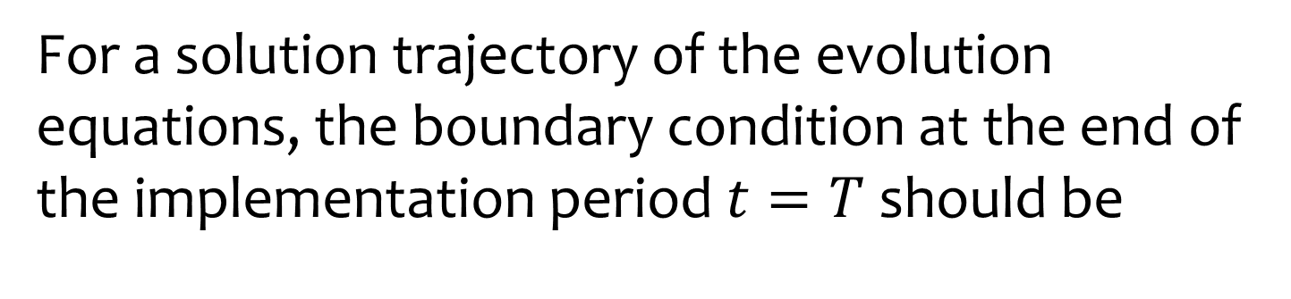

Bounded Value at $t=T$
For a solution trajectory of the evolution equations, the boundary condition at the end of the implementation period $t=T$ should be
Credit Supply
Credit Consumption

Slide 28
Existence of the Equilibrium Point
Every continuous function from a convex compact subset of a Euclidean space to itself has a fixed point.
Brouwer’s fixed point theorem
Fixed-point Problem

Slide 29
Existence of the Equilibrium Point

Slide 30
Uniqueness of the Equilibrium Point

Slide 31
System Stability
time-variant system
time-invariant system

Slide 32
System Stability

Slide 33
System Stability

Slide 34
System Stability

Slide 35
Numerical Example
4.

Slide 36
Numerical Example

Slide 37
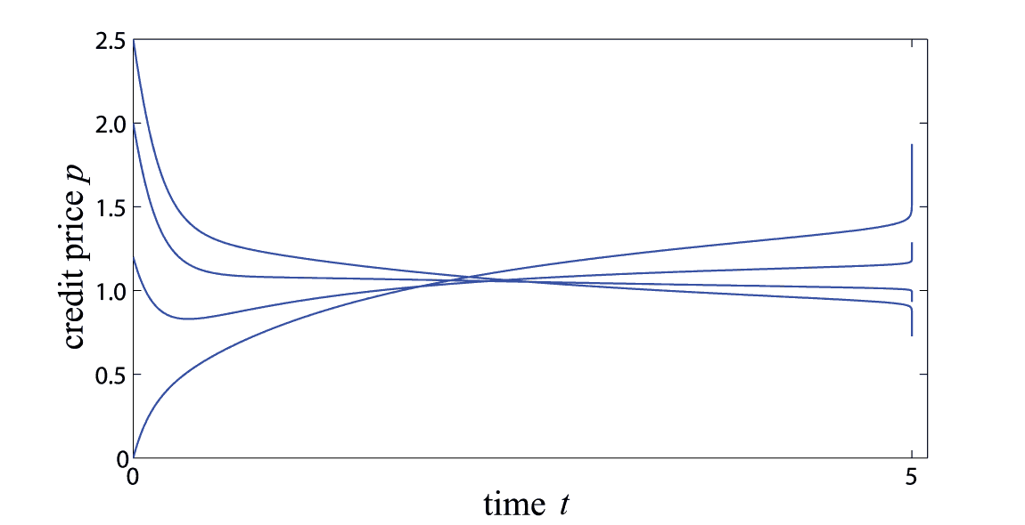
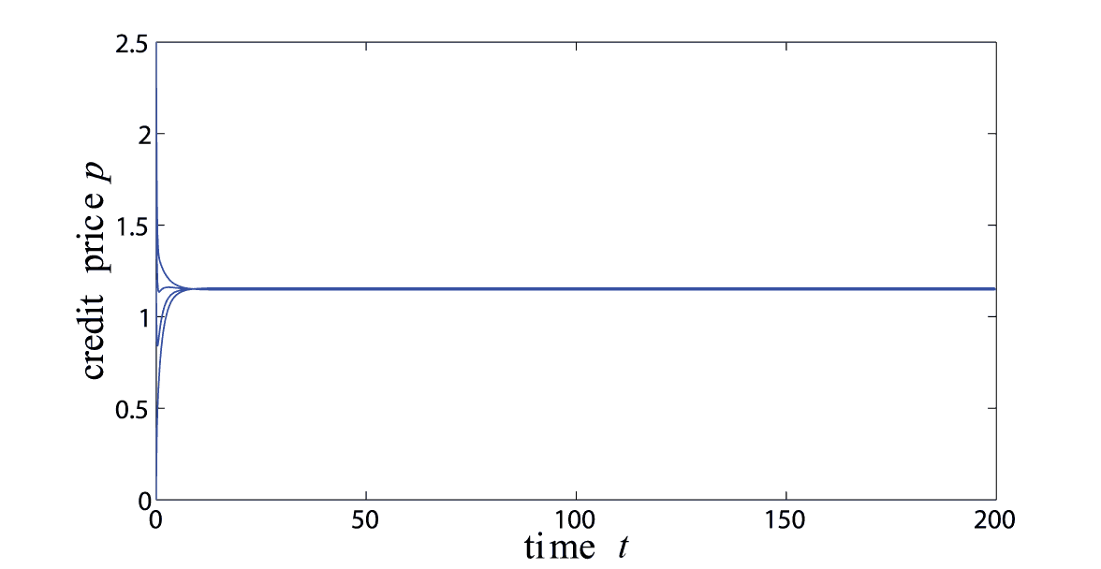
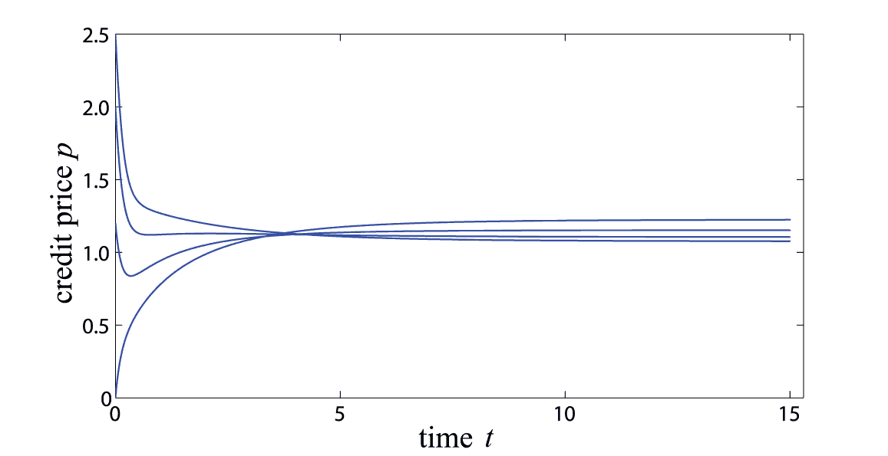



Numerical Example (1)
$$T=5$$
$$T=200$$
  Price evolution with different lengths of time horizon and different initial prices
$$T=15$$

Slide 38
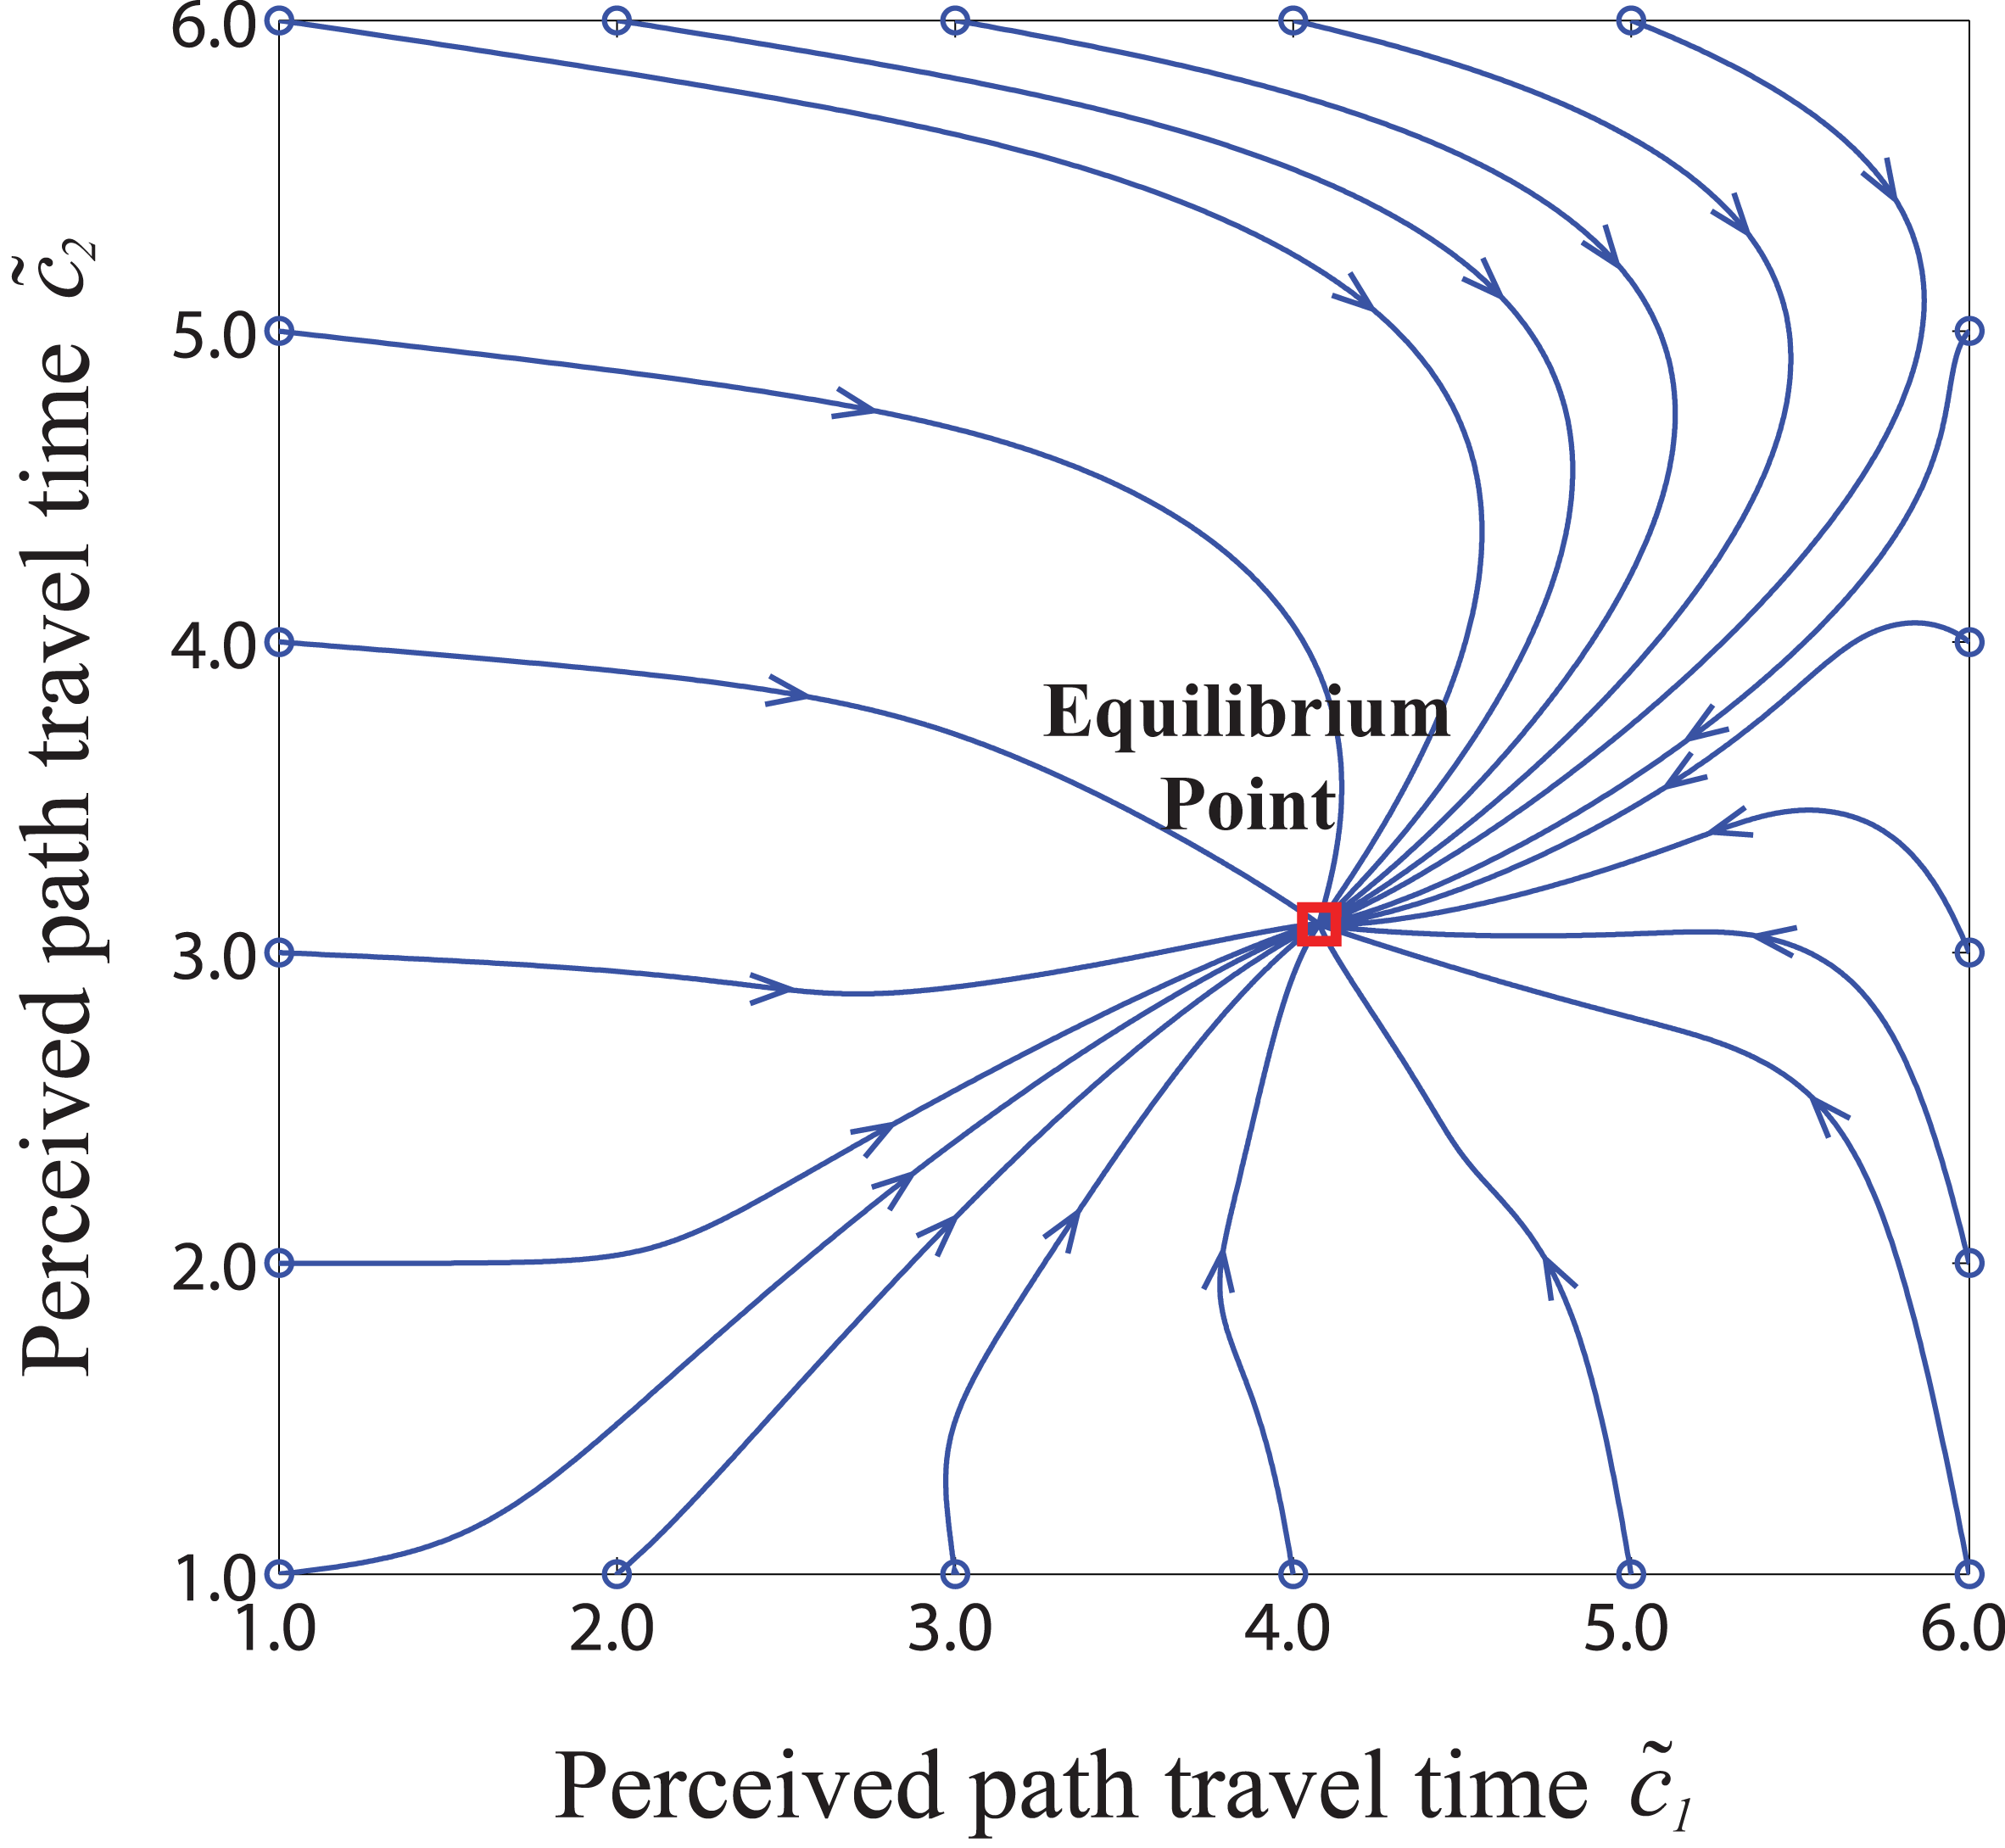
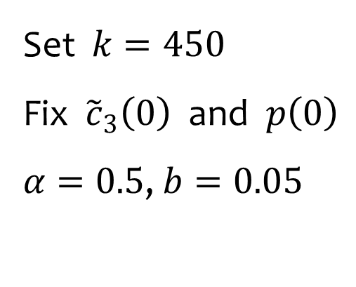
Numerical Example (2)
  Evolution of perceived travel time
  with different initial values
Set $k=450$
Fix ${\tilde{c}}_{3}\left(0\right)$ and $p\left(0\right)$
$α=0.5$, $b=0.05$

Slide 39
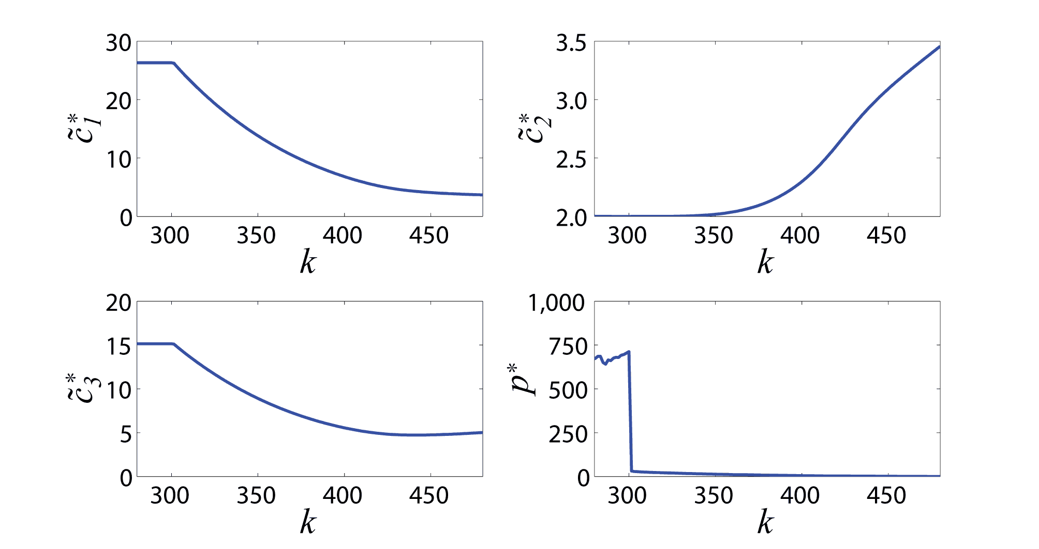

Numerical Example (3)
  Sensitivity of equilibrium points
  w.r.t. different credit distribution
$$k≤300$$

Slide 40
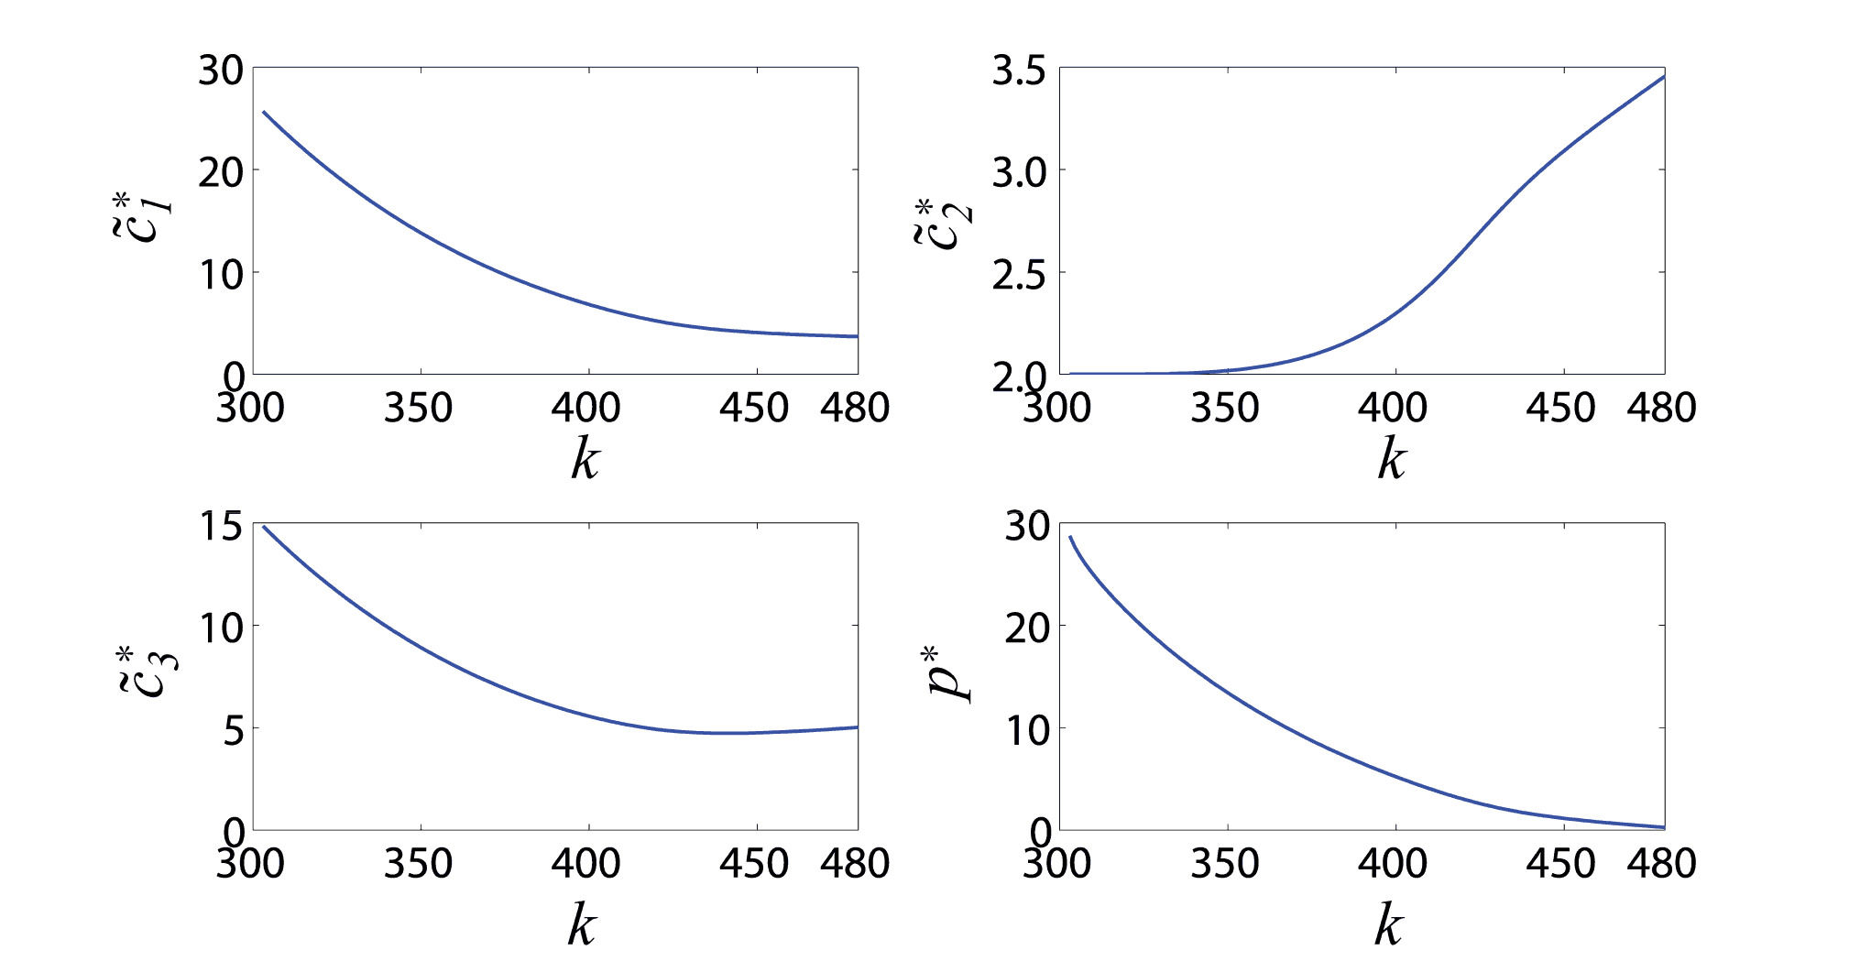
Numerical Example (3)
  Sensitivity of equilibrium points
  w.r.t. different credit distribution

Slide 41
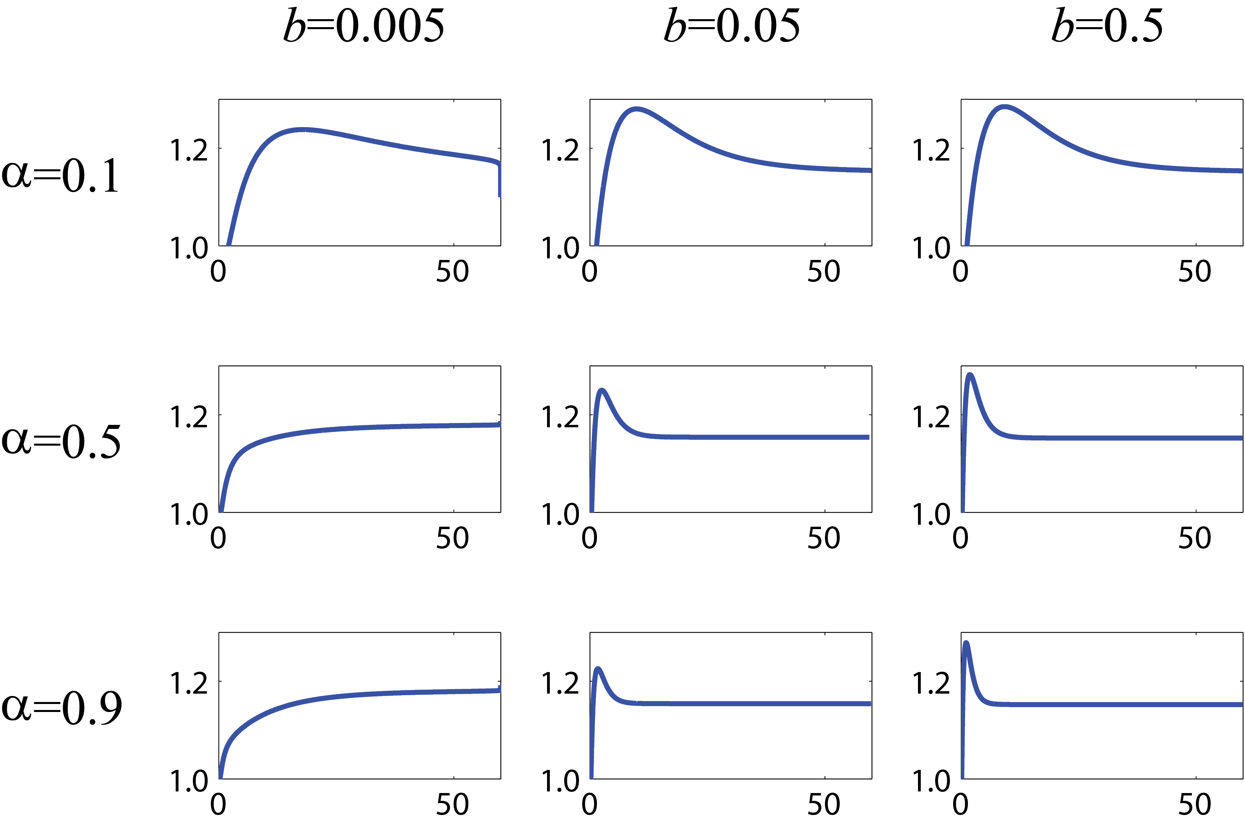
Numerical Example (4)
  Influence of system parameters on price evolution

Slide 42
Conclusion
5.

Slide 43
Conclusion
  A continuous-time model to describe the dynamics of price and perceived travel time under the tradable credit scheme
    fixed demand and homogeneous travelers
    travelers’ route choice and learning behavior
    price evolving with the variation of credit demand and supply
  Some important property of the dynamic model
    existence and uniqueness of the equilibrium point
    stability and convergence when time horizon goes infinite

Slide 44
THANK YOU !

