Slide 1



A Bayesian approach to traffic estimation in stochastic user equilibrium networks
The 20th International Symposium on Transportation and Traffic Theory
Noordwijk, the Netherlands, 17 – 19, July, 2013
Chong WEI
Beijing Jiaotong University
Yasuo ASAKURA
Tokyo Institute of Technology

Slide 2
Purpose
Estimating Traffic flows on congested networks
Path Flows
O-D Matrix
Link Flows

Slide 3
Background
Likelihood-based methods
- Frequentist:
Watling (1994), Lo et al. (1996),
Hazelton (2000), Parry & Hazelton (2012)
- Bayesians:
Maher (1983), Castillo et al. (2008),
Hazelton (2008), Li (2009),
Yamamoto et al. (2009), Perrakis et al. (2012)

Slide 4
Background
On congested networks: Bi-level model
Bi - level
L i k e l i h o o d
Link count constraint
equilibrium constraint

Slide 5
Background
On congested networks: Single level model
B a y e s i a n
L i k e l i h o o d
Link count constraint
equilibrium constraint

Slide 6
Highlights
Use a likelihood to present the estimation problem along with equilibrium constraint
Exactly write down the posterior distribution of traffic flows conditional on both link count data and equilibrium constraint through a Bayesian framework
Develop a sampling-based algorithm to obtain the characteristics of traffic flows from the posterior distribution

Slide 7
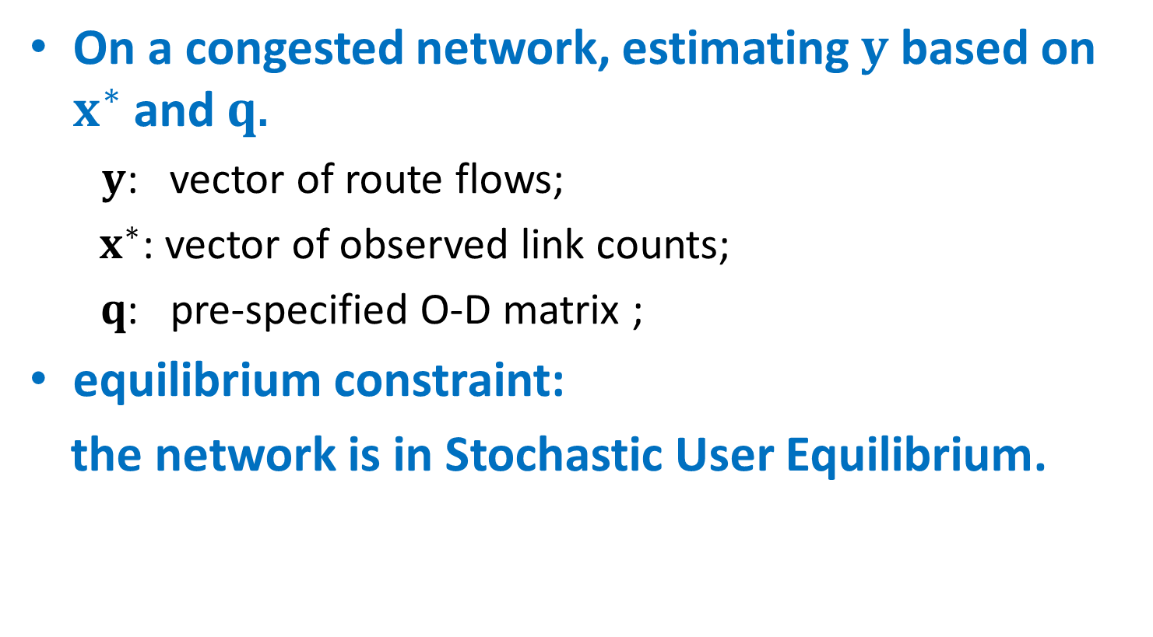
Primary problem
On a congested network, estimating $y$ based on $x^{∗}$ and $q$.
$y$: vector of route flows;
$x^{∗}$: vector of observed link counts;
$q$: pre-specified O-D matrix ;
equilibrium constraint:
the network is in Stochastic User Equilibrium.

Slide 8
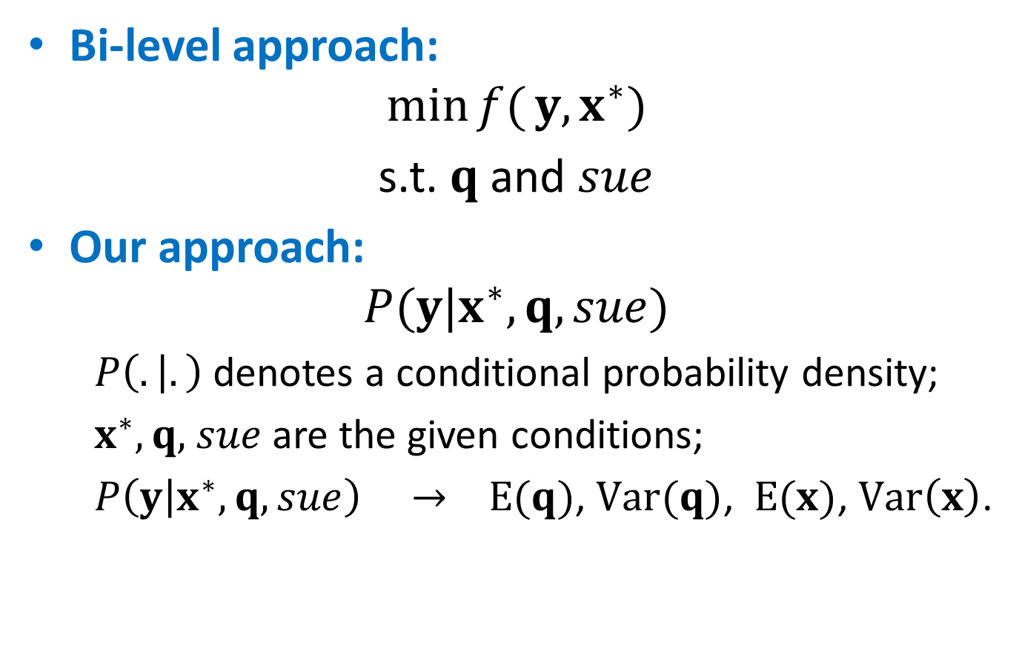
Representation
Bi-level approach:
$$\min{f(}y,x^{∗})$$
s.t. $q$ and $sue$
Our approach:
$$P(y|x^{∗},q,sue)$$
$P\left(. | .\right)$ denotes a conditional probability density;
${ x}^{∗},q,$ $sue$are the given conditions;
$P\left(y | x^{∗},q,sue\right) → E(q)$, $Var(q)$, $E(x)$, $Var\left(x\right)$.

Slide 9




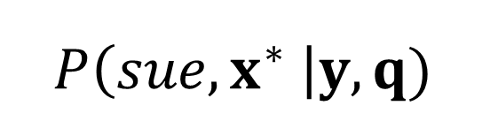




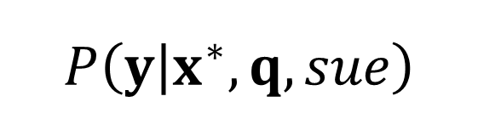

Decomposition
$$P\left(y | x^{∗},q,sue\right)$$
$$posterior$$
$$Beyes^{′}theorem$$
$$P(y|q)$$
$$P\left(sue,x^{∗} \right|y,q)$$
$$prior$$
$$likelihood$$
$$P(x^{∗}|y)$$
$$P\left(sue \right| y,q)$$
$$link couts$$
$$equilibrium$$

Slide 10
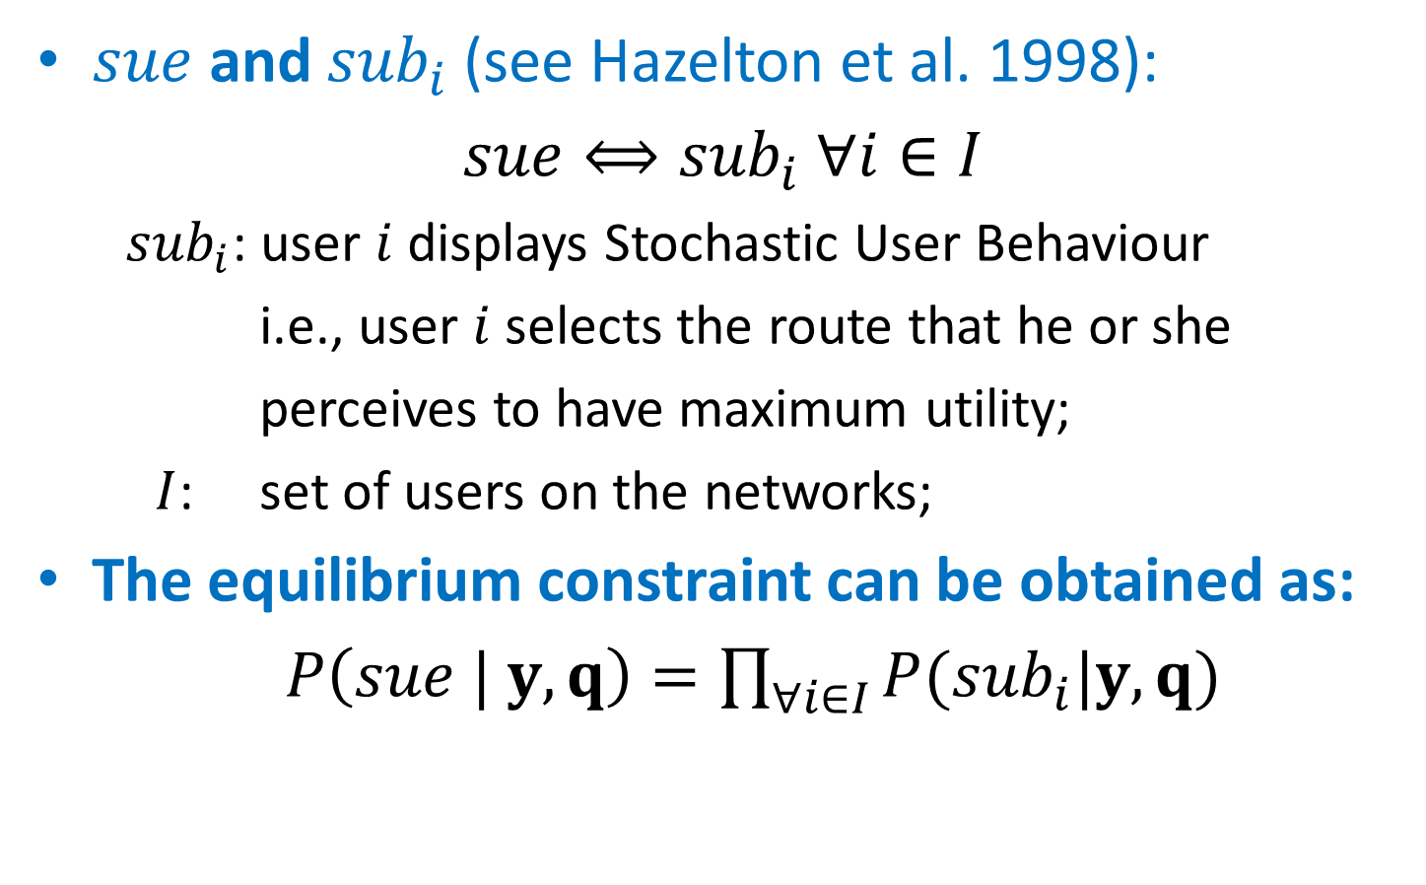
Equilibrium constraint
$sue$ and ${sub}_{i}$ (see Hazelton et al. 1998):
$sue⟺{sub}_{i} ∀i∈I$
${ sub}_{i}$: user $i$ displays Stochastic User Behaviour
i.e., user $i$ selects the route that he or she
perceives to have maximum utility;
$I$: set of users on the networks;
The equilibrium constraint can be obtained as:
$P\left(sue | y, q\right)=\prod_{∀i∈I}{P({sub}_{i}|y, q)}$

Slide 11
An illustrative example
Two-route network
110
Link A
detector
200
Link B
? (90)
O
A
D
91.81
105.15
Proposed model
Equilibrium model
True value = 90
True value = 90

Slide 12
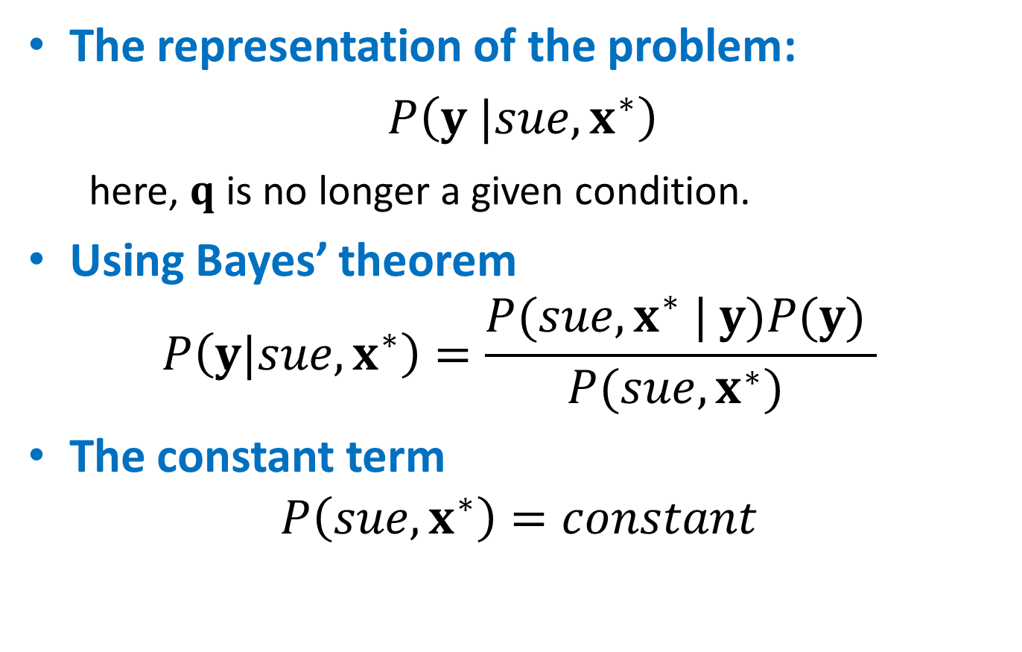
Path flow estimation problem
The representation of the problem:
$P\left(y |sue,x^{∗}\right)$
here, $q$ is no longer a given condition.
Using Bayes’ theorem
$$P\left(y|sue,x^{∗}\right)=\frac{P(sue,x^{∗} | y)P(y) }{P(sue,x^{∗}) }$$
The constant term
$$P\left(sue,x^{∗}\right)=constant$$

Slide 13

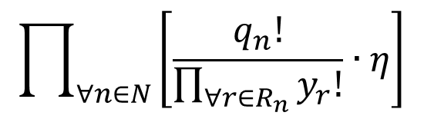
Path flow estimation problem
The posterior distribution
$$P\left(y|sue,x^{∗}\right)∝P(sue,x^{∗} | y)P(y)/P(sue,x^{∗})$$
$$P\left(sue,x^{∗} \right|y,q)$$
$$\prod_{∀n∈N}{\left[\frac{q_{n}!}{\prod_{∀r∈R_{n}}{y_{r}!}}∙η\right]}$$
Likelihood
Prior probability: the principle of indifference

Slide 14
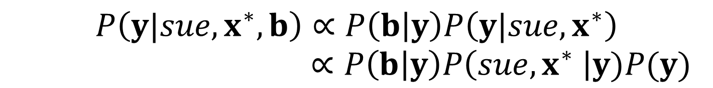
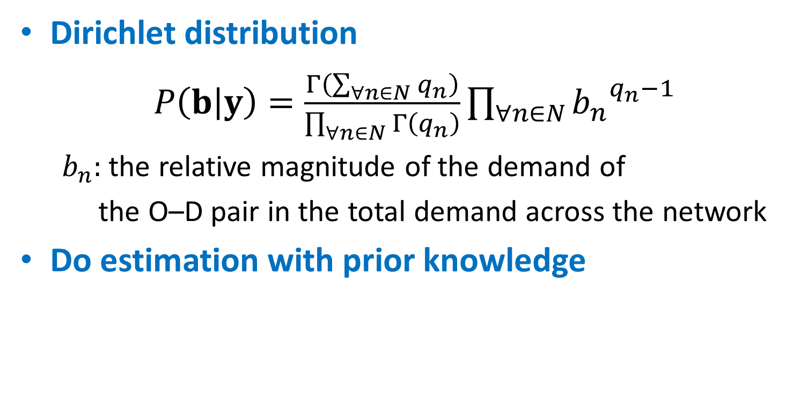
Prior knowledge of O-D matrix
Dirichlet distribution
$P\left(b | y\right)=\frac{Γ\left(\sum_{∀n∈N}{q_{n}}\right)}{\prod_{∀n∈N}{Γ\left(q_{n}\right)}}\prod_{∀n∈N}{{b_{n}}^{q_{n}−1}}$
${ b}_{n}:$ the relative magnitude of the demand of
the O–D pair in the total demand across the network
Do estimation with prior knowledge
$$P\left(y|sue,x^{∗},b\right)∝P\left(b | y\right)P\left(y|sue,x^{∗}\right)$$
$∝P\left(b | y\right)P\left(sue,x^{∗} \right|y)P(y)$

Slide 15





Estimation
Sampling-based algorithm
$$P\left(y|sue,x^{∗}\right)$$
$$E(q)$$
$$E(x)$$
$$Var(q)$$
$$Var(x)$$

Slide 16
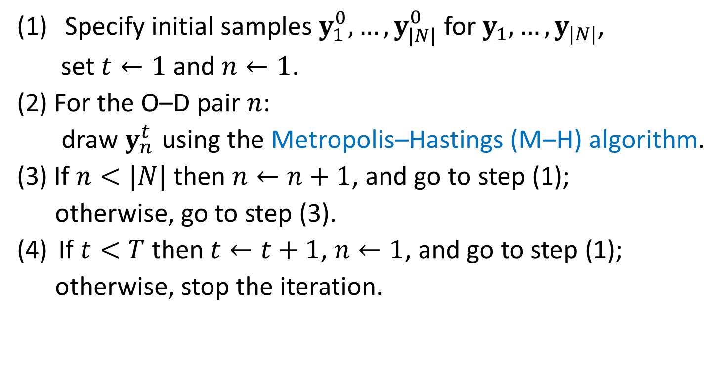
Blocked sampler
Specify initial samples $y_{1}^{0},…,y_{|N|}^{0}$ for $y_{1},…,y_{|N|}$,
set $t←1$ and $n←1$.
(2) For the O–D pair $n$:
draw $y_{n}^{t}$ using the Metropolis–Hastings (M–H) algorithm.
(3) If $n<|N|$ then $n←n+1$, and go to step (1);
otherwise, go to step (3).
If $t<T$ then $t←t+1$, $n←1$, and go to step (1);
otherwise, stop the iteration.

Slide 17
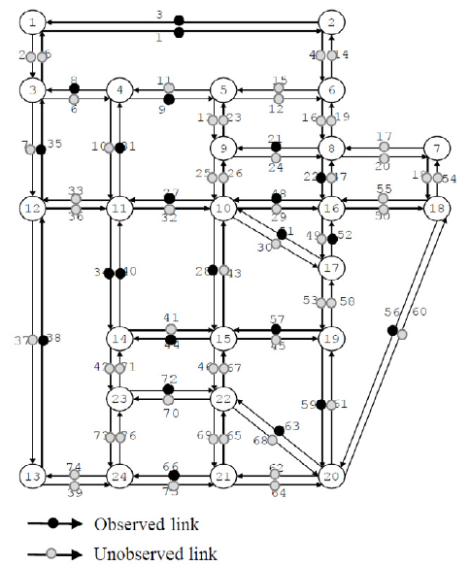
Test network
60 O-D pairs
53 unobserved links
23 observed links
(about 30% of the links)

Slide 18
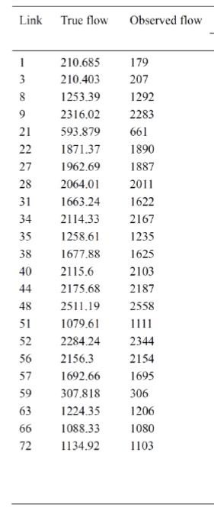
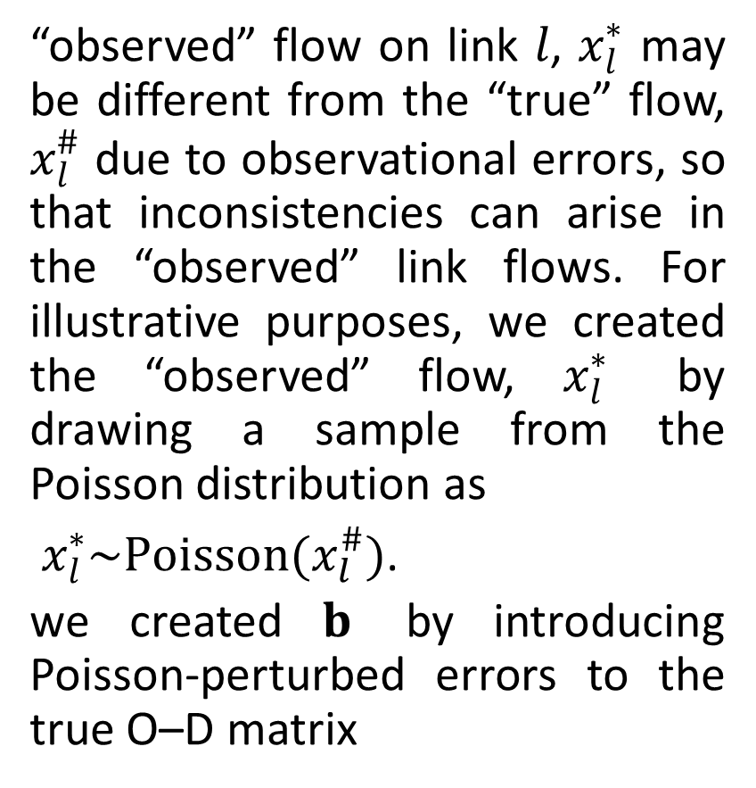
Test network
“observed” flow on link $l$, $x_{l}^{∗}$ may be different from the “true” flow, $x_{l}^{\#}$ due to observational errors, so that inconsistencies can arise in the “observed” link flows. For illustrative purposes, we created the “observed” flow, $x_{l}^{∗}$ by drawing a sample from the Poisson distribution as
$x_{l}^{∗}\sim Poisson(x_{l}^{\#})$.
we created $b$ by introducing Poisson-perturbed errors to the true O–D matrix

Slide 19
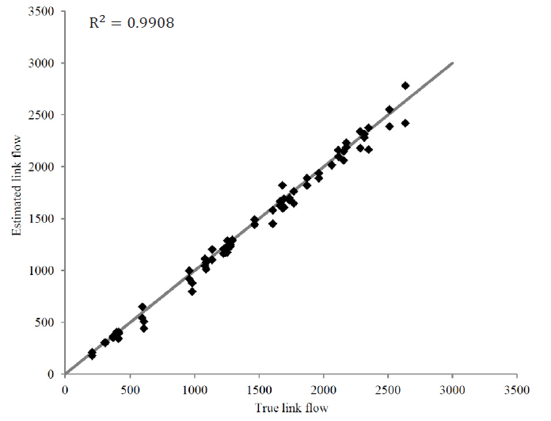
Link estimates without prior knowledge

Slide 20
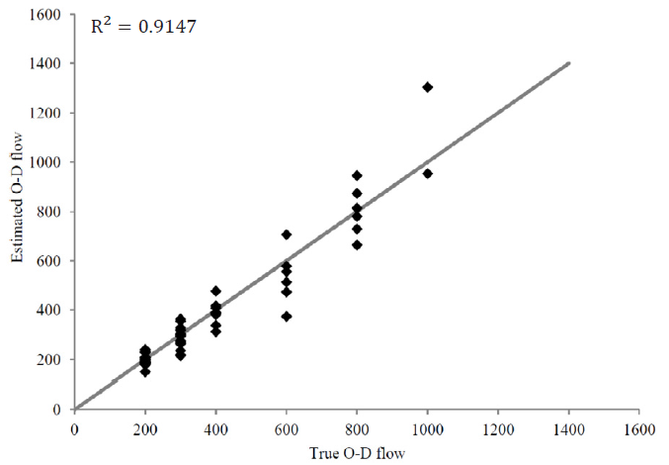
O-D estimates without prior knowledge

Slide 21
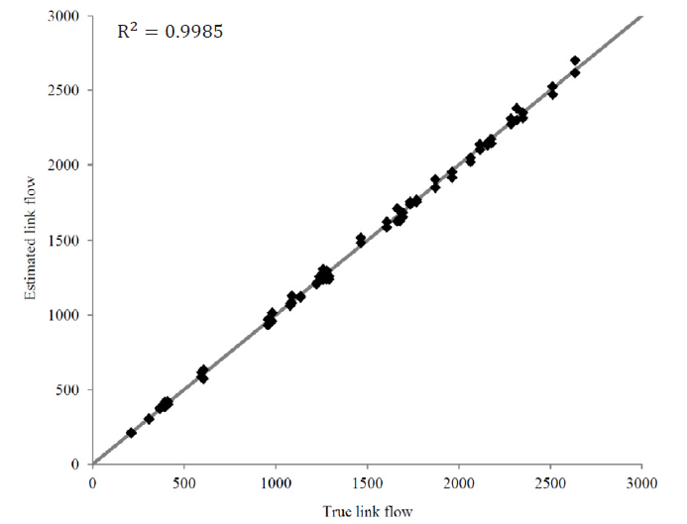
Link estimates with prior knowledge

Slide 22
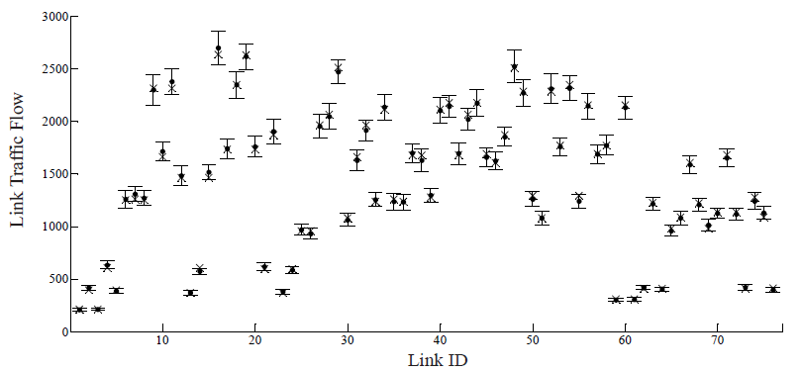
95% Bayesian confidence interval

Slide 23
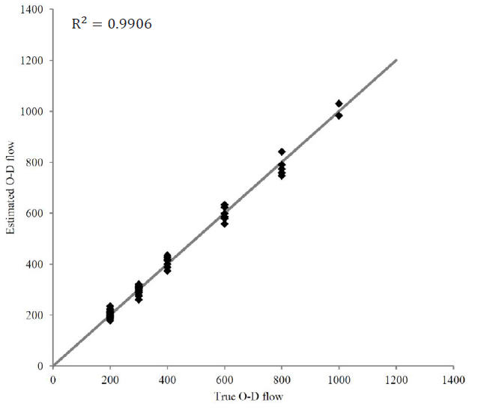
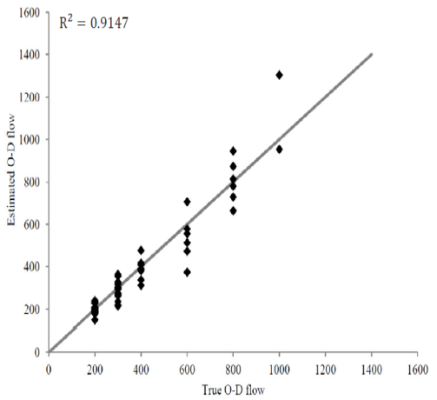
O-D estimates with prior knowledge

Slide 24
Conclusions
A likelihood-based statistical model that can take into account data constraint and equilibrium constraint through a single level structure.
Therefore, the proposed method does not find an equilibrium solution in each iteration.
The proposed model uses observed link counts as input but does not require consistency among the observations.

Slide 25

Conclusions
The probability distribution of traffic flows can be obtained by the proposed model.
No special requirements for route choice models.
The National Basic Research Program of China (No. 2012CB725403)

Slide 26
Questions？
Chong WEI
chwei@bjtu.edu.cn
Yasuo ASAKURA
asakura@plan.cv.titech.ac.jp

