Slide 1
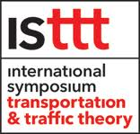
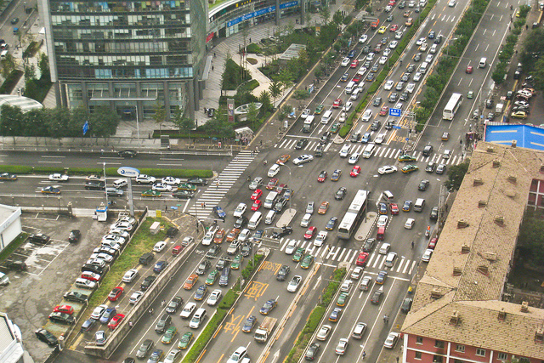
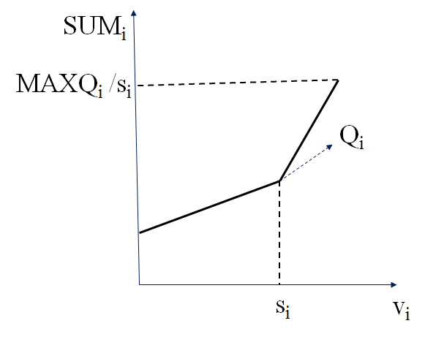





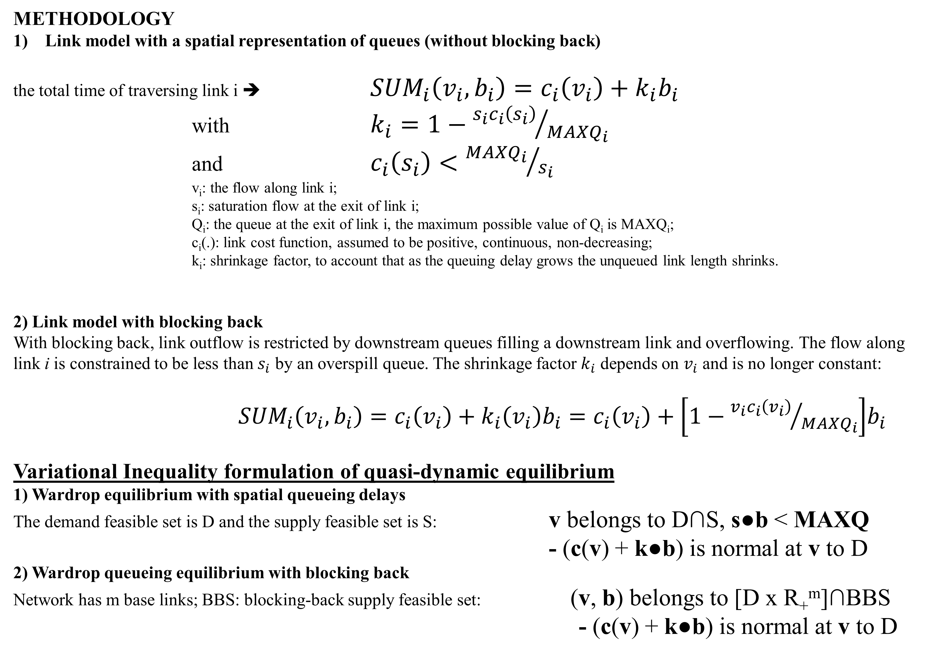
Equilibrium in Capacitated Networks with Queueing Delays, Queue-storage, Blocking Back and Control
ABSTRACT
This paper considers a steady-state, link-based, fixed demand equilibrium model with explicit link-exit capacities, explicit bottleneck or queueing delays and explicit bounds on queue storage capacities. We propose a link model (called spatial queueing model) which takes account of the space taken up by traffic queues and the effects of spillback (when queue storage capacities are exceeded). It is shown how this spatial queueing model fits within a feasible equilibrium model. Results are obtained including: (1) existence of equilibrium with prices (or point queues) and with spatial queueing; (2) existence of equilibrium results (in both a steady state and a dynamic context) which allow signal green-times to respond to prices and (3) existence of equilibrium results which allow signal green-times to respond to spatial queues. Each of the steady state models may be thought of as a stationary solution to the dynamic assignment problem.
MOTIVATIONS
The need to model queueing and spillback in congested traffic networks; these phenomena are not well represented within the simple link performance functions currently utilised in equilibrium models;
Modeling (i) the spatial extent of queues within links and (ii) blocking back propagation of these queues from link to link are both of substantial importance in equilibrium models.
METHODOLOGY
Link model with a spatial representation of queues (without blocking back)
the total time of traversing link i ➔ ${SUM}_{i}\left(v_{i},b_{i}\right)=c_{i}\left(v_{i}\right)+k_{i}b_{i}$
with $k_{i}=1−{s_{i}c_{i}\left(s_{i}\right)}/{{MAXQ}_{i}}$ and $c_{i}\left(s_{i}\right)<{{MAXQ}_{i}}/{s_{i}}$
v_{i}: the flow along link i;
s_{i}: saturation flow at the exit of link i;
Q_{i}: the queue at the exit of link i, the maximum possible value of Q_{i} is MAXQ_{i};
c_{i}(.): link cost function, assumed to be positive, continuous, non-decreasing;
k_{i}: shrinkage factor, to account that as the queuing delay grows the unqueued link length shrinks.
2) Link model with blocking back
With blocking back, link outflow is restricted by downstream queues filling a downstream link and overflowing. The flow along link i is constrained to be less than $s_{i}$ by an overspill queue. The shrinkage factor $k_{i}$ depends on $v_{i}$ and is no longer constant:
${SUM}_{i}\left(v_{i},b_{i}\right)=c_{i}\left(v_{i}\right)+k_{i}\left(v_{i}\right)b_{i}=c_{i}\left(v_{i}\right)+\left[1−{v_{i}c_{i}\left(v_{i}\right)}/{{MAXQ}_{i}}\right]b_{i}$
Variational Inequality formulation of quasi-dynamic equilibrium
1) Wardrop equilibrium with spatial queueing delays
The demand feasible set is D and the supply feasible set is S: v belongs to D∩S, s●b < MAXQ
- (c(v) + k●b) is normal at v to D
2) Wardrop queueing equilibrium with blocking back
Network has m base links; BBS: blocking-back supply feasible set: (v, b) belongs to [D x R₊^{m}]∩BBS
- (c(v) + k●b) is normal at v to D
ILLUSTRATION: A SIMPLE CAPACITATED NETWORK
Link 2 has a saturation flow s₂ at the exit;
link 3 has a saturation flow of s₃ at the exit; all other links have large saturation flows and s₂ < s₃ so the exit of link 3 is a bottleneck;
v_{i} is the flow rate along link i (i = 0, 1, 2, 3); c_{i}(v_{i}) > 0 except for c₀(v₀) = 0;
OD flow from A to B is fixed at T_{AB}.
Equilibrium with spatial queueing
Conditions: c₂(v₂) + c₃(v₃) < c₁(v₁) ≤ c₂(v₂) + MAXb₃
The steady-state equilibrium queueing delay and the equilibrium queue:
b₃ = [c₁(T_{AB} – s₃) – (c₂(s₃) + c₃(s₃))] / [1 – s₃c₃(s₃) / MAXQ₃]
Q₃ = b₃s₃
Equilibrium with spatial queueing and blocking back
Conditions: c₂(v₂) + MAXb₃ < c₁(v₁) ≤ MAXb₂ + MAXb₃
The steady-state equilibrium queueing delay and the equilibrium queue:
b₂ = [(c₁(T_{AB} – s₃) – (c₂(s₃) + c₃(s₃))) – (MAXQ₃/s₃ - c₃(s₃))] / [1 – s₃c₂(s₃) / MAXQ₂]
Q₂ = b₂s₃
Mike Smith
Department of Mathematics, University of York, United Kingdom
Wei Huang
KU Leuven, Belgium
Francesco Viti
University of Luxembourg, Luxembourg

