Slide 1
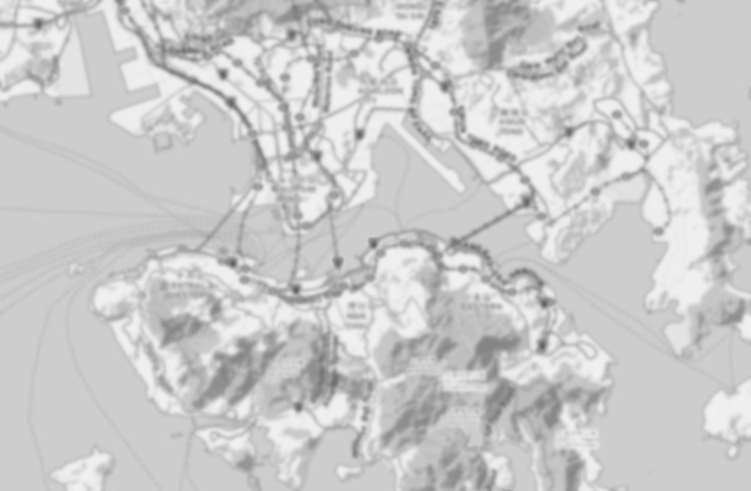
On Joint Railway and Housing Development Strategy
Xiaosu Ma ¹ and Hong K. Lo ²
¹ Singapore-MIT Alliance for Research and Technology
² The Hong Kong University of Science and Technology (cehklo@ust.hk)

Slide 2
Background
Transit Oriented Development (TOD)
Efficient, reliable, environmentally friendly, extensively pursued in Asia, especially China
One critical issue is financial sustainability of rail development
The question is to what extent one can exploit the synergy between rail and property developments
Property development brings in rail patronage, hence higher fare revenue
Improved accessibility due to rail increases values of properties
To what extent property value increases can be used to cross-subsidize rail infrastructure development

Slide 3
Background
Empirical studies
Property values increase in areas near quality transit stations (Hass-Klau et al., 2004; Rodriguez and Targa, 2004; Munoz-Raskin, 2007).
MTRC in Hong Kong
Granted right to develop properties above MTR stations,
Profit from property development cross-subsidizes rail infrastructure investment
50% revenue from rail, property development contributes 90% profit (MTRC, 2010)

Slide 4
Background
Past efforts focus on value capture and investment models (Lo et al., 2008; Tang and Lo, 2008, 2010)
Statistical approaches relate railway development and property value for individual sites
State-of-the-art land-use and transport models are used to study TOD through simulation methods.
Few focused on developing an analytical framework via a combined equilibrium formulation and deriving analytical results

Slide 5
Objective
To study the impact of joint railway and property development strategies on the system performance and benefit distribution among stakeholders.

Slide 6
Outlines
The modeling framework
Properties and sensitivity tests
Numerical example
Conclusion

Slide 7
The modeling framework
1.

Slide 8
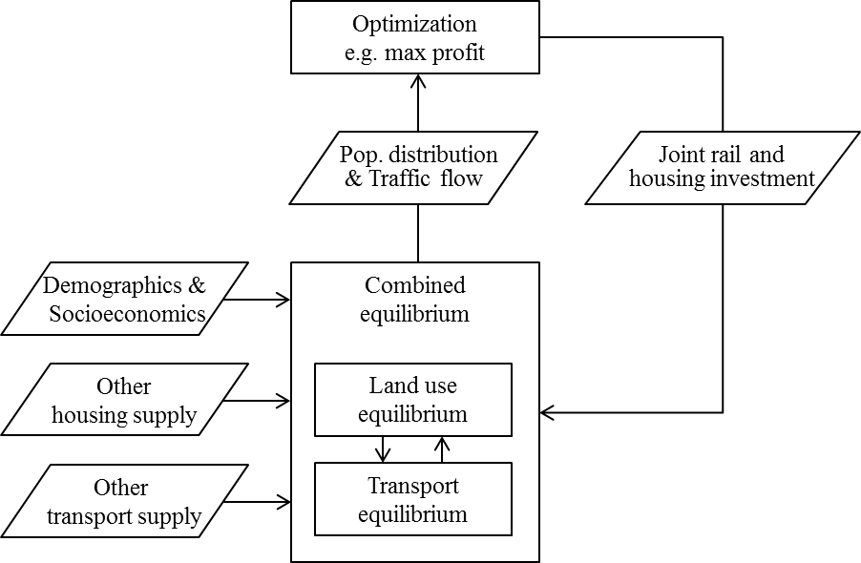
The modeling framework
1
TOD developer
Upper level
Residents
Lower level

Slide 9
The combined equilibrium formulation
1.1
To model heterogeneous residents’ location and travel choices
With given transport network and housing supply
Housing market
Bid rent process

Slide 10
The combined equilibrium formulation
1.1
Formulated as an equivalent Nonlinear Complementarity Problem (NCP)
Lower level decision variables - Z
Utility level index
Rail demand
Auto path flow
Further reformulated as an unconstrained optimization problem by minimizing a gap function to zero
Location choice
Travel choice

Slide 11
Joint railway and housing development
1.2
The upper level story
A profit oriented joint railway and housing developer
Upper level decision variables
Railway service (headway and fare)
Housing supply (housing type and number)
With exogenous total demand
With other competitive travel modes, e.g. auto
Notes:
Objectives for instruction and expected results and/or skills developed from learning.

Slide 12
Joint railway and housing development
1.2
Profit function
Housing revenue
Rail revenue
Housing cost
Rail cost
Notes:
Objectives for instruction and expected results and/or skills developed from learning.

Slide 13
Joint railway and property development
1.2
Mathematical Program with Equilibrium Constraints (MPEC)
s.t.
Gap function for the combined equilibrium
Notes:
Objectives for instruction and expected results and/or skills developed from learning.

Slide 14
Properties and sensitivity tests
2.
Notes:
With the above formulation which combines both residents’ and developers’ decision making process, it is of interest to analyze the resultant benefit redistribution among them due to different railway and housing investment strategies, such as changes in resident consumer surplus, railway and housing developer’ producer surplus, as well as the overall social welfare.

Slide 15
Properties
2
Rail
r
……
s
Auto
Results obtained for the case of
One OD, Multiple travel modes
Heterogeneous housing types
Heterogeneous value of times
Results are echoed by the numerical studies with multiple OD pairs
Notes:
Generally speaking, the analytical results is obtained for the case of simple one OD pair with multiple travel modes.
However, they are echoed by the numerical studies that implement the model for a network with multiple OD pairs.

Slide 16
Properties
2
Rail
Property 1 (Residents)
The travel cost of every HH group is monotonically increasing with headway and fare
The changes of railway investment, e.g. headway or fare, do not result of changes in choice of housing types, and the locational benefit, e.g. individual/total CS, do not change
The neutralizing effect on consumer surplus comes from transport externalities, where decrease in transport cost is absorbed by corresponding rent increases
A regressive effect – High income gain more from transport service improvement
r
……
s
Auto
Notes:
The observations from property 1 are standing from the residents’ point of view
Note that the unchanged consumer surplus for every income group in residential housing choice does not indicate that the overall impact of transport system changes (e.g. headway and fare) on residents of different income groups are the same. Actually, our previous research proved that residents with higher incomes and hence higher values of time benefit more from transport system improvements. Without going into the details of the proof, the intuition is that an improvement in transport infrastructure or reduction in transport cost will lead to an increase in housing rent, which is the same for all income groups and is equal to the travel cost as valued by the lowest income group . The same travel time saving would be valued higher by higher income groups due to their higher values of time. Therefore, for higher income groups, the increase in rental cost is smaller than the travel cost saving gained from transport infrastructure improvement. Hence, higher income groups will gain more from transport infrastructure improvements, or a regressive effect.

Slide 17
Properties
2
Rail
r
……
s
Property 2 (Developer)
The housing rents are monotonically decreasing with headway and fare
If changing headway...
there exists an optimal headway such that PS is maximized in a multi-modal network
Headway ↑ Rail cost/revenue ↓ Housing cost/revenue →
Auto
Notes:
ON the other hand, from the developer point of view, the first obvious observation is that
The most instersting observation is
PS does not change with cp if rail is the only travel mode, since any railway fare increase (reduction) will be fully absorbed in the resultant housing rent by the same level of reduction (increase).
both the railway revenue and cost are monotonically decreasing with the headway, while the housing revenue are monotonically decreasing with the headway

Slide 18
Properties
2
Rail
r
……
s
Property 2 (Developer)
If changing fare...
PS is monotonically decreasing with fare in a multi-modal network
Therefore developer will keep fare at a low level to maintain the PS at a high level, since the gain from housing sale offsets the reduction in fare revenue
PS does not change with fare if rail is the only travel mode, fare increase fully absorbed in housing rent by the same level of reduction.
Auto
Notes:
PS does not change with cp if rail is the only travel mode, since any railway fare increase (reduction) will be fully absorbed in the resultant housing rent by the same level of reduction (increase).
both the railway revenue and cost are monotonically decreasing with the headway, while the housing revenue are monotonically decreasing with the headway

Slide 19
Sensitivity tests
2
One OD pair
Two travel modes
Two income groups
Two types of housing unit
Sensitivity tests
Either fix Fare, and vary the number of Big units and Headway
Or fix Headway, and vary the number of Big units and Fare
Rail
r
s
Auto
Notes:
The above properties are also validated by sensitivity tests
Again, we assume an example of one OD…
Two sets of tests are conducted,

Slide 20
Sensitivity tests
2
Vary Headway and % of Big units
Rail
r
s
Auto
Optimal investment
The total profit
Private developer
The social welfare
Government
Notes:
These two figures show the resultant profit and social welfare when we altering
For the private developer, there exists an
If compared with other objective, for example, if the developer is the government who is to max the SW, then the test also give us the same optimal headway value, but it suggests to build more Big housing units.
Because Big gives more

Slide 21
Sensitivity tests
2
Rail
Vary Fare and % of Big units
r
s
Auto
Keep fare low
The total profit
Private developer
The social welfare
Government
Notes:
While on the other hand, the government may want both reducing and increasing so as to max SW

Slide 22
Numerical example
3.
Notes:
Because the overall proble is formulated as a MPEC, where normally it is hard to find and prove the existance of global optimal, we can stiil validate properties discovered under one OD case by numerical examples with multiple OD pairs.

Slide 23
Numerical example
3
Numerical example
With multiple OD pairs
Investing on
Railway 2
Zone 3 & 4
Scenarios
Scenario 1 – Optimal joint investment
Scenario 2 – Non-optimal (the same as old zones and Railway 1)
Scenario 3 – Only optimizing headway and fare (the same as old zones)
1
1
R1_1
2
2
6
R1_2
5
R2_2
R2_1
CBD
4
3
4
3
Notes:
Objectives for instruction and expected results and/or skills developed from learning.

Slide 24
Numerical example
3
Scenarios 1 – Optimal joint investment
Investment decisions
Lower headway on R2
Larger proportion of Small units
More units in Zone 4
Residents’ choice
Higher rail share in new zones
Higher rail share in zone 4
1
1
R1_1
2
2
6
R1_2
5
R2_2
R2_1
CBD
4
3
4
3
Notes:
Objectives for instruction and expected results and/or skills developed from learning.

Slide 25
Numerical example
3
Comparison among scenarios
Optimal joint investment decisions (S1) is better not only in profit but also in consumer surplus and social welfare
Joint investment
Non-optimal
Optimal rail
Outcome indicators | Scenario 1 | Scenario 2 |  | Scenario 3
Total travel time | 533 | 589 | -9.6% | 539 | -1.1%
Total consumer surplus | 1,340 | 1,237 | 8.3% | 1,238 | 8.3%
Housing profit | 313 | 212 | 47.2% | 225 | 39.0%
Railway profit | -127 | -150 | -15.0% | -123 | 3.7%
Total profit | 185 | 62 | 196.3% | 102 | 81.6%
Social welfare | 187 | 63 | 192.6% | 103 | 80.7%
Notes:
Generally, the performances of Scenario A are better than the other two Scenarios in most aspects. The joint housing and railway investment scheme not only maximizes the developer’s total profit, but also results in higher consumer surplus and social welfare. In addition, it also reduces the total travel time. These results show that the joint housing and railway development performs better than separate housing and railway investment decisions, as it is more flexible in internalizing the tradeoff between housing and transport investments and revenues. The results also re-iterate that joint housing and railway development tends to improve the transport sysem performance on its own intiative, as evidenced in the total system travel time, which could be over-compensated by corresponding rental gains.

Slide 26
Numerical example
3
Comparison among scenarios
S1 is more flexible in finding tradeoff between rail and housing investment
E.g. Private developer tends to improve the rail system performance on its own initiative
Outcome indicators | Scenario 1 | Scenario 2 |  | Scenario 3
Total travel time | 533 | 589 | -9.6% | 539 | -1.1%
Total consumer surplus | 1,340 | 1,237 | 8.3% | 1,238 | 8.3%
Housing profit | 313 | 212 | 47.2% | 225 | 39.0%
Railway profit | -127 | -150 | -15.0% | -123 | 3.7%
Total profit | 185 | 62 | 196.3% | 102 | 81.6%
Social welfare | 187 | 63 | 192.6% | 103 | 80.7%
Notes:
Objectives for instruction and expected results and/or skills developed from learning.

Slide 27
Conclusions
4.

Slide 28
Conclusions
4
Developed a broader analytical framework of the integrated LUT system
Investigated the performance of a joint rail and housing investment strategy for a single profit oriented developer
Analytically studied the impact of such joint investment on the benefit distribution of different stakeholders under one OD condition
Numerical studies demonstrate the possibility of this joint investment on cross-subsidy between housing and rail investment
Notes:
Objectives for instruction and expected results and/or skills developed from learning.

Slide 29
Future extensions
4
To extent this study into long-term framework so as to investigate the detailed cross-subsidy scheme over time
To investigate and compare the performances among various PPP modes
To investigate how to develop planning regulations on large-scale projects invested by private developers, e.g. TOD, so as to balance the interests of all the stakeholders
Notes:
Objectives for instruction and expected results and/or skills developed from learning.

Slide 30
Thank you

