Slide 1
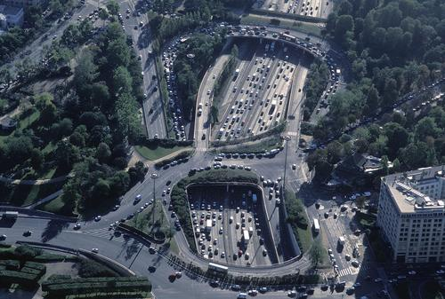
A variational formulation for higher order macroscopic traffic flow models of the GSOM family
J.P. Lebacque
UPE-IFSTTAR-GRETTIA
Le Descartes 2, 2 rue de la Butte Verte
F93166 Noisy-le-Grand, France
Jean-patrick.lebacque@ifsttar.fr
M.M. Khoshyaran
E.T.C. Economics Traffic Clinic
34 Avenue des Champs-Elysées,
75008, Paris, France
www.econtrac.com
ISTTT 20, July 17-19, 2013

Slide 2
Outline of the presentation
Basics
GSOM models
Lagrangian Hamilton-Jacobi and variational interpretation of GSOM models
Analysis, analytic solutions
Numerical solution schemes

Slide 3
Scope
The GSOM model is close to the LWR model
It is nearly as simple (non trivial explicit solutions fi)
But it accounts for driver variability (attributes)
More scope for lagrangian modeling, driver interaction, individual properties
Admits a variational formulation
Expected benefits: numerical schemes, data assimilation

Slide 4
The LWR model

Slide 5
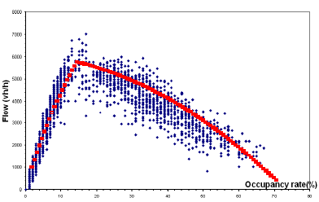
The LWR model in a nutshell (notations)
Introduced by Lighthill, Whitham (1955), Richards (1956)
The equations:
Or:

Slide 6
Solution of the inhomogeneous Riemann problem
Analytical solutions, boundary conditions, node modeling
Density
Position

Slide 7
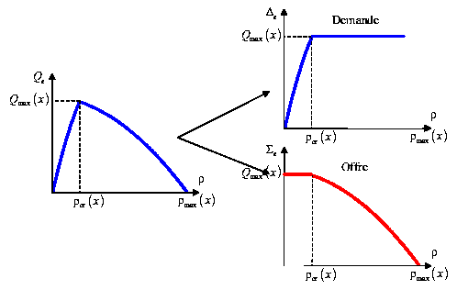
The LWR model: supply / demand
the equilibrium supply and demand functions (Lebacque, 1993-1996)
Demand
Supply

Slide 8
The LWR model: the min formula
The local supply and demand:
The min formula
Usage: numerical schemes, boundary conditions → intersection modeling

Slide 9
Inhomogeneous Riemann problem (discontinuous FD)
Solution with Min formula
Can be recovered by the variational formulation of LWR (Imbert Monneau Zidani 2013)
Time
(a,0 )
(b,0 )
(a )
(b )
Position

Slide 10
GSOM models

Slide 11
GSOM (Generic second order modelling) models
(Lebacque, Mammar, Haj-Salem 2005-2007)
In a nutshell
Kinematic waves = LWR
Driver attribute dynamics
Includes many current macroscopic models

Slide 12
GSOM Family: description
Conservation of vehicles (density)
Variable fundamental diagram, dependent on a driver attribute (possibly a vecteur) I
Equation of evolution for I following vehicle trajectories (example: relaxation)

Slide 13
GSOM: basic equations
Conservation des véhicules
Dynamics of I along trajectories
Variable fundamental Diagram

Slide 14
Example 0: LWR (Lighthill, Whitham, Richards 1955, 1956)
No driver attribute
One conservation equation

Slide 15
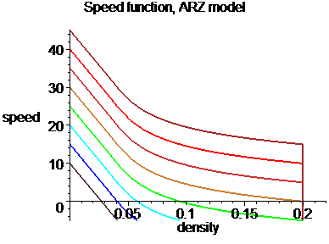
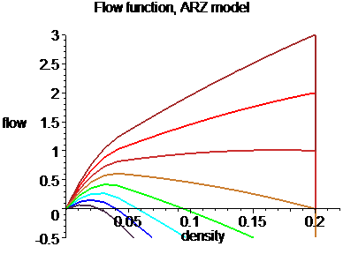
Example 1: ARZ (Aw,Rascle 2000, Zhang,2002)
Lagrangien attribute I = difference between actual and mean equilibrium speed

Slide 16
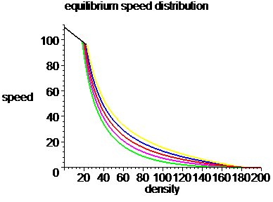
Example 2: 1-phase Colombo model (Colombo 2002, Lebacque Mammar Haj-Salem 2007)
Variable FD (in the congested domain + critical density)
Increasing values of I
The attribute I is the parameter of the family of FDs

Slide 17
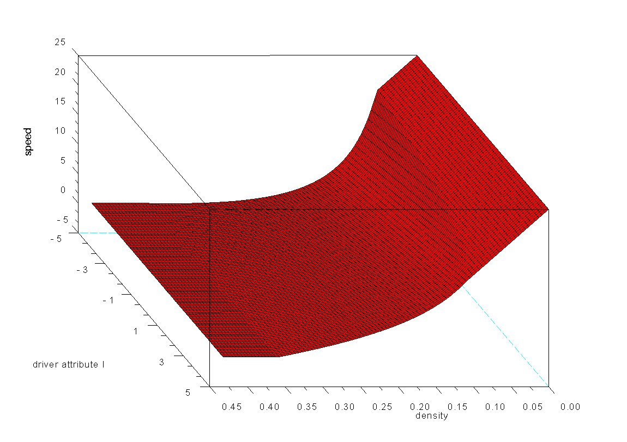
Fundamental Diagram (speed-density)

Slide 18
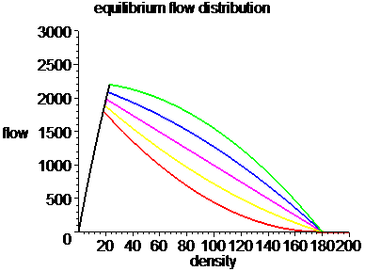
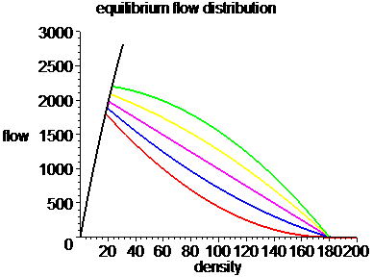
Example 2 continued (1-phase Colombo model)
1-phase vs 2-phase: Flow-density FD
modéle 1-phase
modéle 2-phase

Slide 19
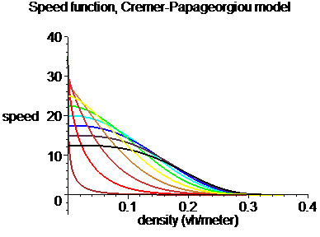
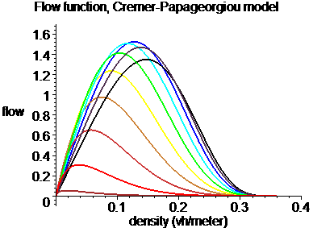
Example 3: Cremer-Papageorgiou
Based on the Cremer-Papageorgiou FD (Haj-Salem 2007)

Slide 20



Example 4: « multi-commodity » models
GSOM Model
+ advection (destinations, vehicle type)
= multi-commodity GSOM

Slide 21
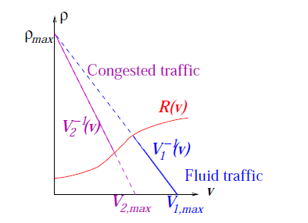


Example 5: multi-lane model
Impact of multi-lane traffic
Two states: congestion (strongly correlated lanes) et fluid (weakly correlated lanes)
→ 2 FDs separated by the phase boundary R(v)
Relaxation towards each regime
→ eulerian source terms

Slide 22
Example 6: Stochastic GSOM (Khoshyaran Lebacque 2007-2008)
Idea:
Conservation of véhicles
Fundamental Diagram depends on driver attribute I
I is submitted to stochastic perturbations (other vehicles, traffic conditions, environment)

Slide 23
Two fundamental properties of the GSOM family (homogeneous piecewise constant case)
1. discontinuities of I propagate with the speed v of traffic flow
2. If the invariant I is initially piecewise constant, it stays so for all times t > 0
⇒ On any domain on which I is uniform the GSOM model simplifies to a translated LWR model (piecewise LWR)

Slide 24
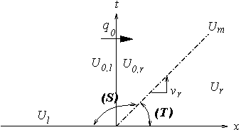
Inhomogeneous Riemann problem
I = I_{l} in all of sector (S)
I = I_{r} in all of sector (T)
ρ_{l}
v_{l}
ρ_{r}
v_{r}
x
FD_{l}
FD_{r}

Slide 25
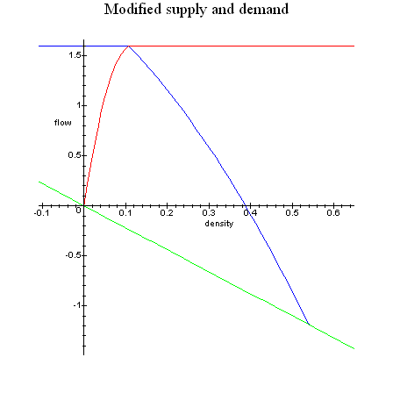
Generalized (translated) supply- Demand (Lebacque Mammar Haj-Salem 2005-2007) Example: ARZ model
Translated Supply / Demand = supply resp demand for the « translated » FD (with resp to I )

Slide 26
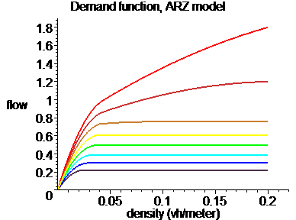
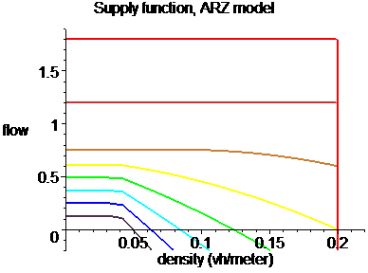
Example of translated supply / demand: the ARZ family

Slide 27
Solution of the Riemann problem (summary)
Define the upstream demand, the downstream supply (which depend on I_{l} ):
The intermediate state U_{m} is given by
The upstream demand and the downstream supply (as functions of initial conditions) :
Min Formula:

Slide 28
Applications
Analytical solutions
Boundary conditions
Intersection modeling
Numerical schemes

Slide 29
Lagrangian GSOM; HJ and variational interpretation

Slide 30
Variational formulation of GSOM models
Motivation
Numerical schemes (grid-free cf Mazaré et al 2011)
Data assimilation (floating vehicle / mobile data cf Claudel Bayen 2010)
Advantages of variational principles
Difficulty
Theory complete for LWR (Newell, Daganzo, also Leclercq Laval for various representations )
Need of a unique value function

Slide 31
Lagrangian conservation law
t
Spacing r
The rate of variation of spacing r depends on the gradient of speed with respect to vehicle index N
r
x
The spacing is the inverse of density

Slide 32



Lagrangian version of the GSOM model
Conservation law in lagrangian coordinates
Driver attribute equation (natural lagrangian expression)
We introduce the position of vehicle N:
Note that:

Slide 33

Lagrangian Hamilton-Jacobi formulation of GSOM (Lebacque Khoshyaran 2012)
Integrate the driver-attribute equation
Solution:
FD Speed becomes a function of driver, time and spacing

Slide 34
Lagrangian Hamilton-Jacobi formulation of GSOM
Expressing the velocity v as a function of the position X

Slide 35


Associated optimization problem
Define:
Note implication: W concave with respect to r (ie flow density FD concave with respect to density
Associated optimization problem

Slide 36
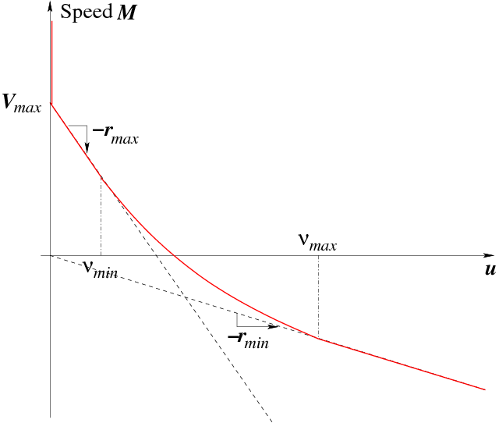
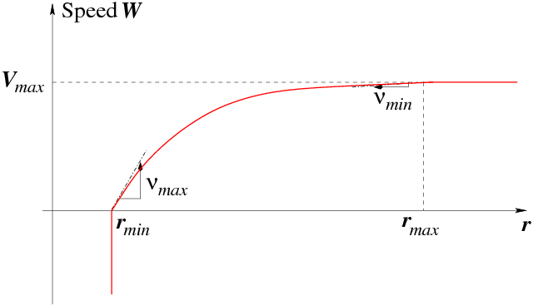
Functions M and W

Slide 37
Illustration of the optimization problem:
Initial/boundary conditions:
Blue: IC + trajectory of first vh
Green: trajectories of vhs with GPS
Red: cumulative flow on fixed detector
t
N

Slide 38
Elements of resolution

Slide 39

Characteristics
Optimal curves → characteristics (Pontryagin)
Note: speed of charcteristics: > 0
Boundary conditions

Slide 40
Initial conditions for characteristics
t
IC
Vh trajectory
N
Notes:
Conditions de saut??

Slide 41

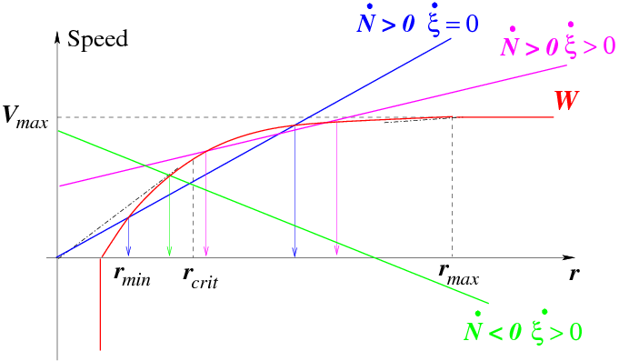
Initial / boundary condition
Usually two solutions r₀ (t )
t

Slide 42
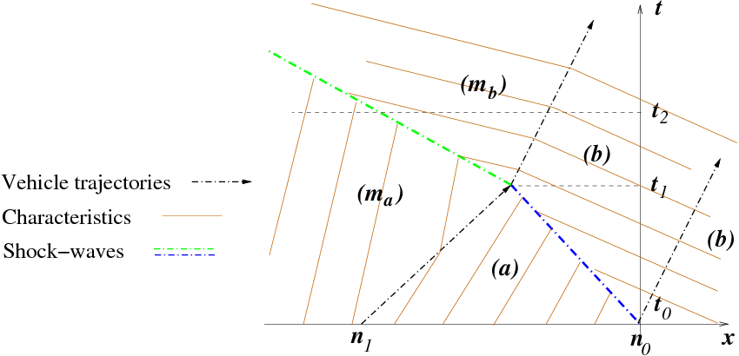
Example: Interaction of a shockwave with a contact discontinuity Eulerian view

Slide 43
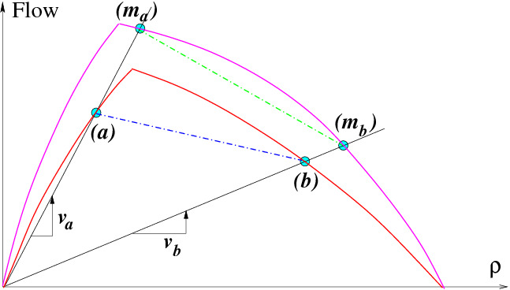
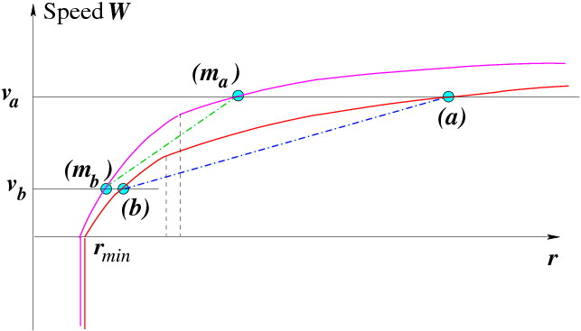
Initial conditions:
Top: eulerian
Down: lagrangian

Slide 44
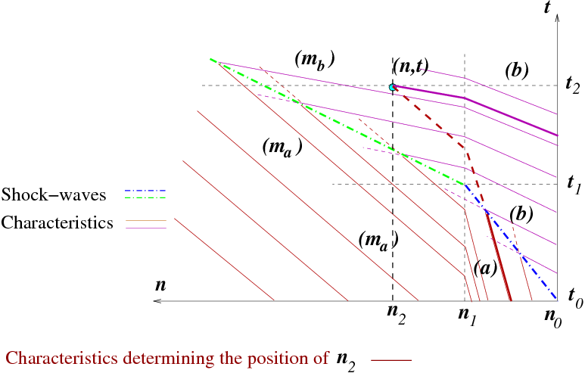
Example: Interaction of a shockwave with a contact discontinuity Lagrangian view

Slide 45
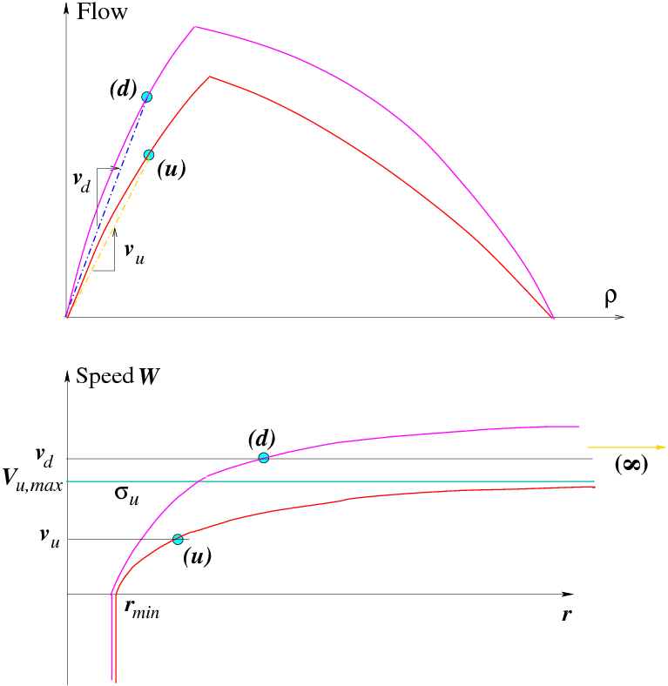
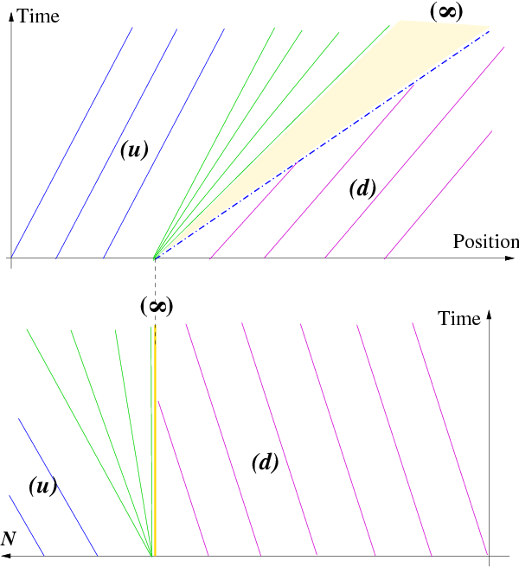
Another example: total refraction of characteristics and lagrangian supply
???

Slide 46

Decomposition property (inf-morphism)
The set of initial/boundary conditions is union of several sets
Calculate a partial solution (corresponding to a partial
set of IBC)
The solution is the min of partial solutions

Slide 47

The optimality pb can be solved on characteristics only
This is a Lax-Hopf like formula
Application: numerical schemes based on
Piecewise constant data (including the system yielding I )
Decomposition of solutions based on decomposition of IBC
Use characteristics to calculate partial solutions

Slide 48
Numerical scheme based on characteristics (continued)
If the initial condition on I is piecewise constant →
the spacing along characteristics is piecewise constant
Principle illustrated by the example: interaction between shockwave and contact discontinuity

Slide 49
Alternate scheme: particle discretization
Particle discretization of HJ
Use charateristics
Yields a Godunov-like scheme (in lagrangian coordinates)
BC: Upstream demand and downstream supply conditions

Slide 50
Numerical example
Model: Colombo 1-phase, stochastic
Process for I : Ornstein-Uhlenbeck, two levels (high at the beginning and end, low otherwise) → refraction of charateristics and waves
Demand: Poisson, constant level
Supply: high at the beginning and end, low otherwise → induces backwards propagation of congestion
Particles: 5 vehicles
Duration: 20 mn
Length: 3500 m

Slide 51
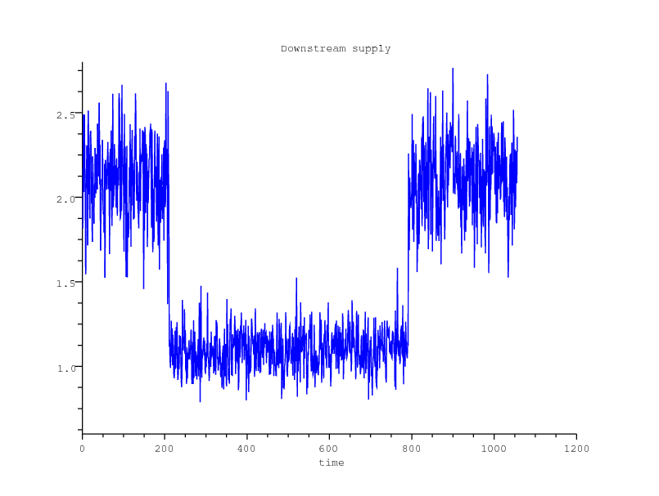
Downstream supply

Slide 52
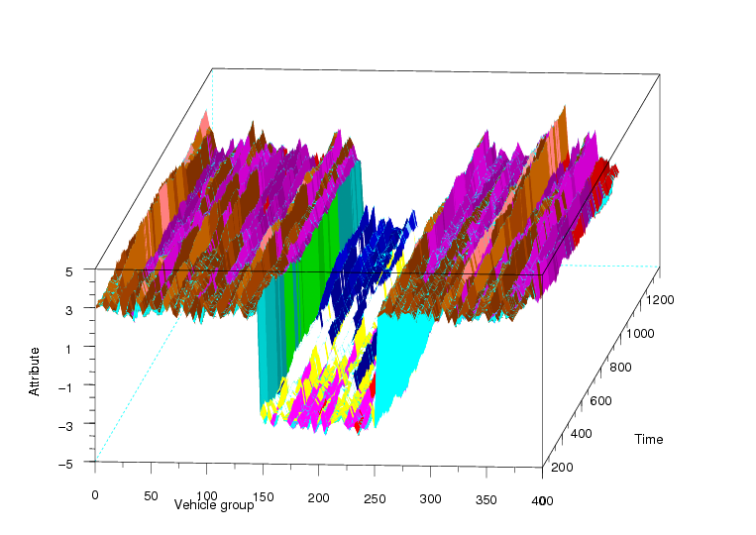
I dynamics

Slide 53
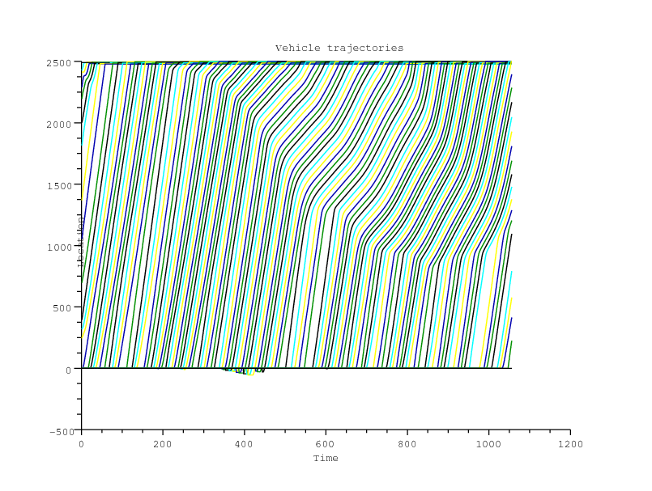
Particle trajectories

Slide 54
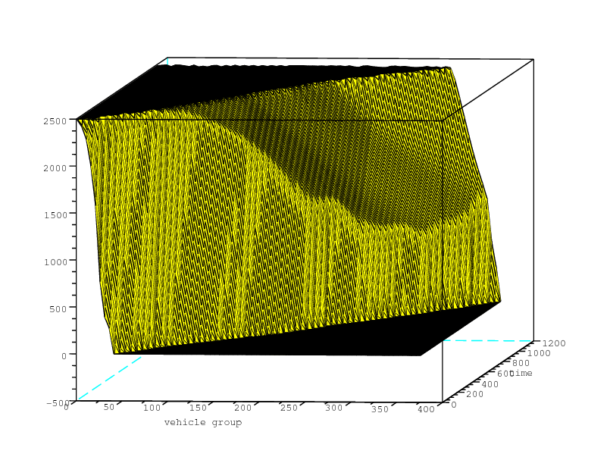
Position of particles

Slide 55
Conclusion
Directions for future work:
Problem of concavity of FD
Eulerian source terms
Data assimilation pbs
Efficient numerical schemes

