Slide 1
Linear-Quadratic Model Predictive Control for Urban Traffic Networks
1
1
2
Tung Le , Hai L. Vu , Yoni Nazarathy,
Bao Vo and Serge Hoogendoorn
1
3
1 Swinburne Intelligent Transport Systems Lab, Australia
2 The University of Queensland, Australia
3 Delft University of Technology, The Netherlands
ISTTT 20, Noordwijk, July 17-19, 2013

Slide 2
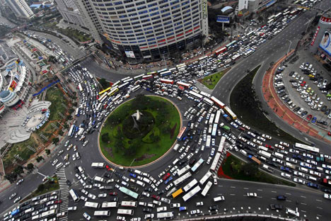
Motivation
Growing demand for transportation
Increasing congestion in the urban area
The need for a real time, coordinated and traffic responsive road traffic control system
ISTTT 20, Noordwijk, July 17-19, 2013

Slide 3
Aims and Outcomes
To develop a better centralized and responsive control
New framework to coordinate the green time split and turning fraction to maximize throughput (and reduce congestion) in urban networks
Explicitly consider link travel time and spill-back
The state prediction is linear that is suitable for large networks control
The optimization problem is formulated as a tractable quadratic programming problem
ISTTT 20, Noordwijk, July 17-19, 2013

Slide 4
Outline
Background and literature review
Proposed MPC framework
Predictive model
Optimization problem
Simulation and results
ISTTT 20, Noordwijk, July 17-19, 2013

Slide 5
Outline
Background and literature review
Proposed MPC framework
Predictive model
Optimization problem
Simulation and results
ISTTT 20, Noordwijk, July 17-19, 2013

Slide 6
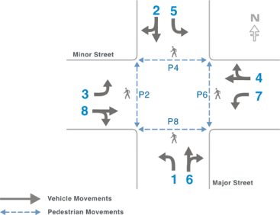
Review of Intersection Control
Traffic signals at intersections is the main method of control in road traffic networks
Have big influence on overall throughput
Control variables at intersections
Phase combination
Cycle time
Split
Offset
ISTTT 20, Noordwijk, July 17-19, 2013

Slide 7
Control strategy classification
Fixed-time coordinated
MAXBAND(John D. C. Little 1966).
TRANSYT(D.I. Robertson 1969).
Coordinated traffic responsive
SCOOT(Bretherson 1982) and SCAT(Lowrie 1982).
TUC(C. Diakaki 1999).
Rolling-horizon optimization.
Coordinated
Isolated fixed-time
SIGSET(Allsop 1971) and SIGCAP(Allsop1976) systems.
G. Importa and G.E. Cantarella(1984).
Isolated traffic-responsive
A.J. Miller(1963).
Isolated
Fixed-time
Traffic-responsive
ISTTT 20, Noordwijk, July 17-19, 2013

Slide 8
Control strategy classification
Fixed-time coordinated
MAXBAND(John D. C. Little 1966).
TRANSYT(D.I. Robertson 1969).
Coordinated traffic responsive
SCOOT(Bretherson 1982) and SCAT(Lowrie 1982).
TUC(C. Diakaki 1999).
Rolling-horizon optimization.
SCOOT and SCAT systems.
Control splits, offset and cycle time.
Use real time measurement to evaluate the effects of changes.
TUC system.
Control splits.
Store and forward model: Assume vertical queue, continuous flow.
Linear Quadratic Regulator problem.
Rolling-horizon optimization.
Coordinated
Isolated fixed-time
SIGSET(Allsop 1971) and SIGCAP(Allsop1976) systems.
G. Importa and G.E. Cantarella(1984).
Isolated traffic-responsive
A.J. Miller(1963).
Isolated
Fixed-time
Traffic-responsive
ISTTT 20, Noordwijk, July 17-19, 2013

Slide 9
Rolling horizon optimization
Demand(n)
Demand(n+1)
State(n)
State(n+1)
…
State(n+N)
Control(n)
Control(n+1)
Optimization over finite horizon N
OPAC(Gartner (1983)), PRODYN(Henry (1983)), CRONOS(Boillot (1992)), RHODES (Mirchandani (2001)) and MPC variant models (Aboudolas (2010), Tettamanti(2010)).
ISTTT 20, Noordwijk, July 17-19, 2013

Slide 10
Outline
Background and literature review
Proposed MPC framework
Predictive model
Optimization problem
Simulation and results
ISTTT 20, Noordwijk, July 17-19, 2013

Slide 11
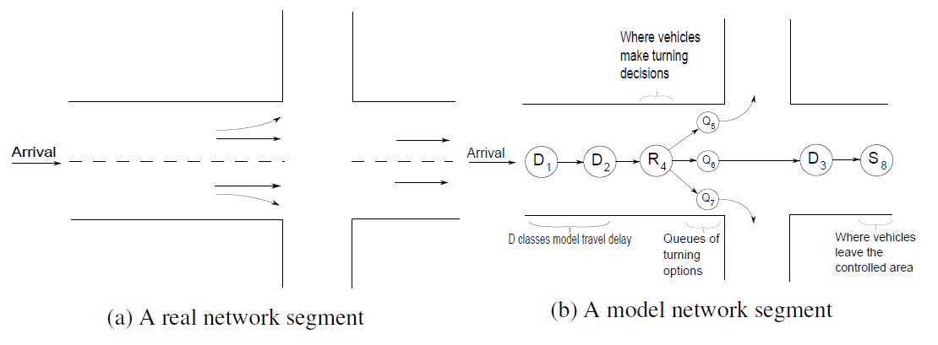
Definitions and Notations
System evolves in discrete time steps n=0,1,2,… where each time unit is also a (fixed) traffic cycle time
Network state maintains continuous vehicle count in delay, route, queue and sink classes
ISTTT 20, Noordwijk, July 17-19, 2013

Slide 12
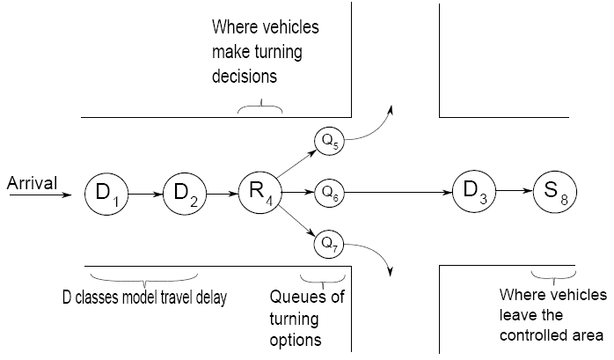
Definitions Cont.
Delay class represents a portion of a multiple-lane street where vehicles just have one turning option to move to its downstream D or R class.
ISTTT 20, Noordwijk, July 17-19, 2013

Slide 13
Definitions Cont.
Route class represents a portion of a multiple-lane street where under the assumption of full drivers’ compliance, the turning rates to downstream queues can possibly be controlled
ISTTT 20, Noordwijk, July 17-19, 2013

Slide 14
Definitions Cont.
Queue class represents a queue in a specific turning direction before an intersection
ISTTT 20, Noordwijk, July 17-19, 2013

Slide 15
Definitions Cont.
Sink class maintains cumulative counts of arrivals to a destination
ISTTT 20, Noordwijk, July 17-19, 2013

Slide 16
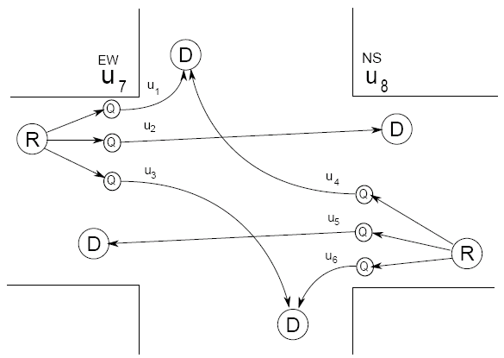
Network and control variables
Vehicles move to downstream classes though links j=1,…,L
fj max number of vehicles go through link j in one time slot (link flow rate)
uj(n) control variable defines the fraction of a time unit during which link j is active at time step n
assume all intersections are of the West-East/North-South type
Time fractions determine both the flow of vehicles from Q classes
and effective turning rates at intersections from R classes
ISTTT 20, Noordwijk, July 17-19, 2013

Slide 17


State dynamics
is the queue length of class k at time n
is exogenous arrival
is the number of vehicles arriving from other classes
is the number of vehicles leaving class k
ISTTT 20, Noordwijk, July 17-19, 2013

Slide 18

Constraints
Control constraints:
The number of vehicles that move through link j is a non-negative number and less than or equal to the max link flow rate fj
Traffic light cycle constraints:
The sum of green duration of all phases have to be less than or equal to a cycle time
ISTTT 20, Noordwijk, July 17-19, 2013

Slide 19


Constraints
Green duration constraints:
The active time of a link across an intersection must be less than or equal to the corresponding green split duration
Flow conflict constraints:
The sum of active time of conflicted links have to less than or equal to the corresponding green split duration
ISTTT 20, Noordwijk, July 17-19, 2013

Slide 20



Constraints
Non-negative queue constraints:
Capacity constraints:
The number of leaving vehicles will be limited by the capacities of its downstream classes
Spill back: #vehicles move downstream =
min (#vehicles upstream, available capacity downstream and fj)
Nonlinear, yet the model remains linear!
ISTTT 20, Noordwijk, July 17-19, 2013

Slide 21
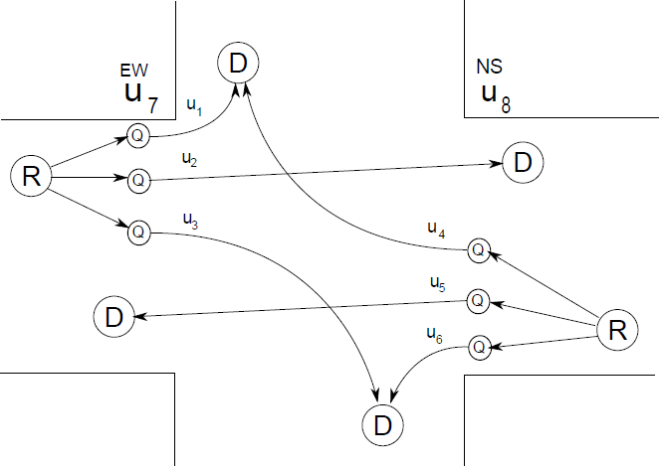


Constraints illustration
Control constraints:
Traffic light cycle constraints:
Green duration constraints:
Flow conflict constraints:
ISTTT 20, Noordwijk, July 17-19, 2013

Slide 22
Matrix representation
State evolution (in one step):
where
U_{l} is the link active time
U_{t} is the green duration
ISTTT 20, Noordwijk, July 17-19, 2013

Slide 23

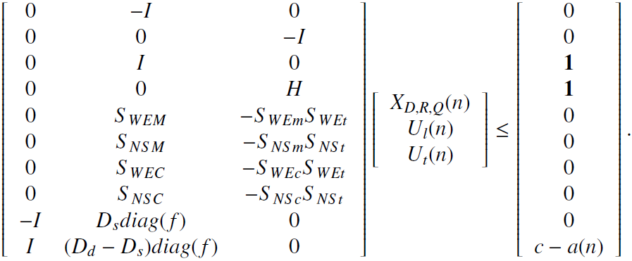
Matrix representation (constraints)
control constraints
Linear constraints:
traffic light cycle
green duration
flow conflict
non-negative queue
capacity constraints
ISTTT 20, Noordwijk, July 17-19, 2013

Slide 24
Outline
Background and literature review
Proposed MPC framework
Predictive model
Optimization problem
Simulation and results
ISTTT 20, Noordwijk, July 17-19, 2013

Slide 25






The MPC framework
Linear model
…
Optimization over finite horizon N
ISTTT 20, Noordwijk, July 17-19, 2013

Slide 26
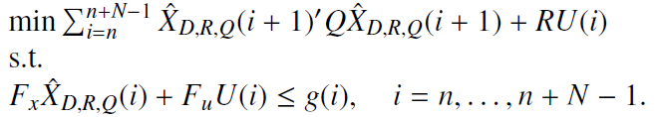
Quadratic Programming
is all 1 matrix, positive semi-definite. Minimize the quadratic cost which is a square sum of all queues over horizon N
Holding back problem: vehicles are held back even when there is available space in the downstream queues
The linear cost gives small incentive for the controller to move vehicle forward
ISTTT 20, Noordwijk, July 17-19, 2013

Slide 27
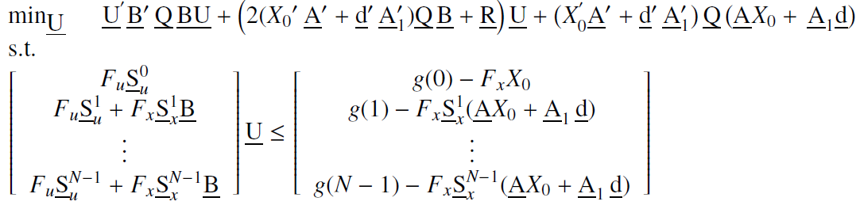
Matrix representation of the QP
Prove that the above QP is convex but not strictly convex (i.e. there could be multiple optimal solutions)
ISTTT 20, Noordwijk, July 17-19, 2013

Slide 28
Outline
Background and literature review
Proposed MPC framework
Predictive model
Optimization problem
Simulation and results
ISTTT 20, Noordwijk, July 17-19, 2013

Slide 29
Simulation and results
Conduct simulations to obtain the performance of the proposed MPC framework.
Achieved similar performance in terms of throughput
Significantly reduce congestion
Network state
MATLAB or SUMO simulation
Optimization solver
Control decision
ISTTT 20, Noordwijk, July 17-19, 2013

Slide 30
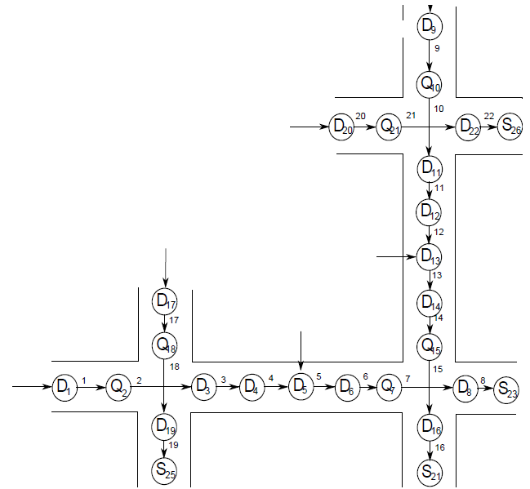
Scenario 1: Symmetric Gating
ISTTT 20, Noordwijk, July 17-19, 2013

Slide 31
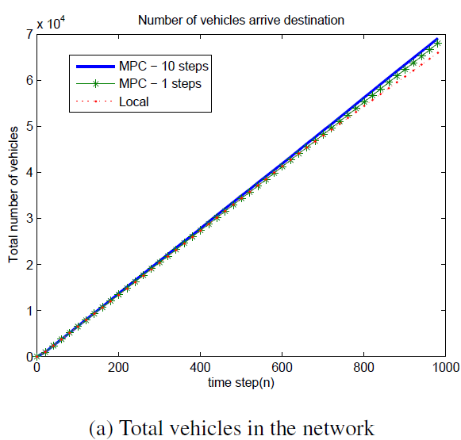
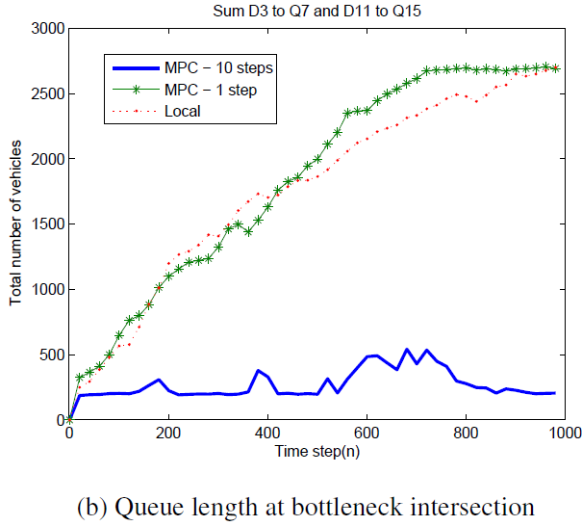
Results for scenario 1
ISTTT 20, Noordwijk, July 17-19, 2013

Slide 32
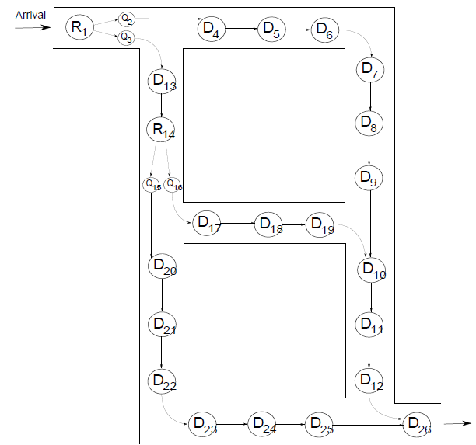
Scenario 2: Routing enable network
ISTTT 20, Noordwijk, July 17-19, 2013

Slide 33
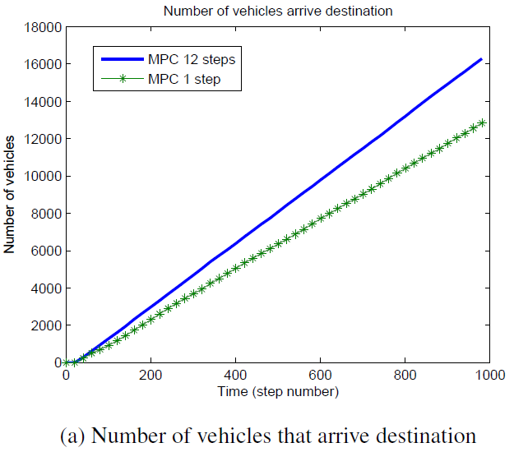
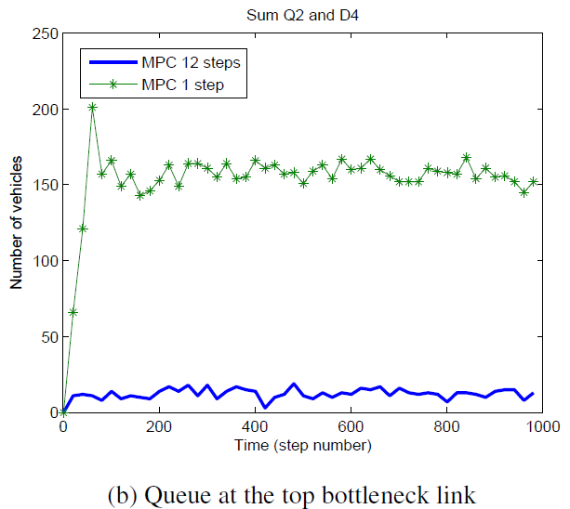
Results for scenario 2
ISTTT 20, Noordwijk, July 17-19, 2013

Slide 34
Conclusion
Developed a general Model Predictive Control framework for centralized traffic signals and route guidance systems aiming to maximize network throughput and minimize congestion
Explicitly considered link travel time, spill back while retaining linearity and tractability
Numerical experiments show significant congestion reduction while still achieving same or better throughput
ISTTT 20, Noordwijk, July 17-19, 2013

Slide 35
Acknowledgements
This work was supported by the Australian Research Council (ARC) Future Fellowships grant FT12010072
and
The 2012/13 Victoria Fellowship Award in Intelligent Transport Systems research
ISTTT 20, Noordwijk, July 17-19, 2013

Slide 36
THANK YOU
ISTTT 20, Noordwijk, July 17-19, 2013

