Slide 1
On Activity-Based
Network Design Problems
Jee Eun (Jamie) Kang, Joseph y. j. Chow, and Will W. Recker
20th international symposium on transportation and traffic theory
7/17/2013

Slide 2
Motivation
Transportation Planning in general had been negligent of travel demand dynamics.
Activity-Based Travel Demand Models are maturing
Network Design Problem has been negligent of travel demand dynamics.

Slide 3
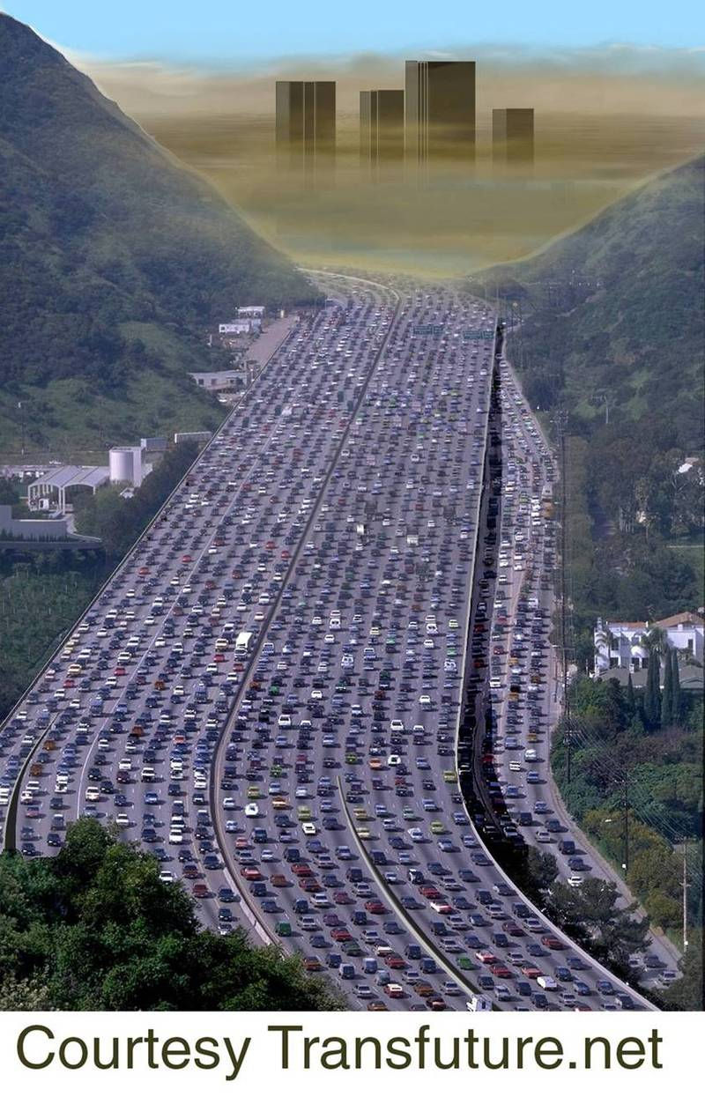
Motivation
“dinner” activity following “work”
  Departure time adjustment
  Mode choice
  Destination choice
  Activity participation
  Sequence of activities
Aggregate time-dependent activity-based traffic assignment (Lam and Yin, 2001)
No NDP with individual traveler’s travel demand dynamics
Dinner at 7 pm
Free Flow Travel Time:
30 minutes
Work ends 6pm
Notes:
Despite having the greatest need for such consideration, there are no NDP models at the planning level that consider routing and scheduling choices of travelers. It has long been acknowledged that models of traveler activities and time use are much more accurate than statistical trip-based approaches ([3], [14]). Activity consideration can bring about a tighter integration of infrastructure investment with land use planning and demand management strategies. Activity-based models can capture realistic impacts on travelers that are not limited to single trips but rather to chains of trips and activities forming detailed daily itineraries.
The second is the aggregate time-dependent activity-based traffic assignment model of Lam and Yin [21]. Both modeling frameworks address the issue of activity scheduling, although Lam and Yin’s model gives up disaggregate itinerary route choices and trip chains in favor of capturing congestion effects

Slide 4
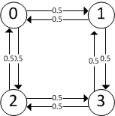
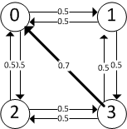
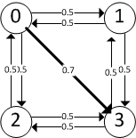
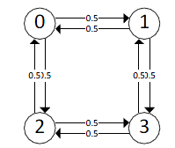
Motivating
Examples
18:30
19:00
18:30
17:42
17:30
19:00
Grocery Shopping
Grocery Shopping
17:30
Network LOS
  Influences HHs on daily itinerary
    Departure time adjustment
    Activity sequence adjustment
17:30
Work
17:00
17:00
9:00
8:30
Work
Work
Grocery Shopping
9:00
7:30
9:00
H
Grocery Shopping:
Start [5,20]
For 1 hr
Return before 22
7:00
8:00
8:18
Work:
Start at 9
For 8 hr
Return before 22

Slide 5
Motivating
Examples
19:25
19:50
19:50
19:25
Social
18:25
Social
18:25
Network LOS
  Paradoxical cases
    link investment that generates traffic without any increase in activity participation
    Improvement result in higher disutility
Waiting time
17:45
Home
17:30
17:00
17:42
17:00
Work
Work
9:00
9:00
8:00
8:00
H
Social Activity:
Start at 18.25
For 1 hr
Return before 22
Work:
Start at 9
For 8 hr
Return before 22

Slide 6
Network Design Problem (NDP)
Strategic or tactical planning of resources to manage a network
Roadway Network Design Problems
  “Optimal decision on expansion of a street and highway system in response to a growing demand for travel” (Yang and Bell, 1998)
  Congestion effect
  Route choice: “selfish traveler”
  Bi-level structure
    Upper Level: NDP
    Lower Level: Traffic Assignment
Notes:
Network design problems (NDPs) are a class of optimization models related to strategic or tactical planning of resources to manage a network [1].
The rationale behind dynamic network design problems is rooted in bi-level NDPs that feature congestion effects. These NDPs operate primarily in civil infrastructure systems, as other types of networks do not generally share the same “selfish travelers” assumptions. In this paradigm, the performance of infrastructure improvements is assumed to depend primarily on the route choices of travelers (the commuter) during peak periods of travel, which in turn depend on the choices of other travelers. The dynamic component further allows modelers to assess intelligent transportation systems (ITS) that require more realistic modeling of traffic propagation obeying physical queuing constraints and information flow. Some examples include the stochastic dynamic NDP from Waller and Ziliaskopoulos [4], Heydecker’s [5] NDP with dynamic user equilibrium (DUE), the linear DUE-NDP from Ukkusuri and Waller [6], dynamic toll pricing problem with route and departure time choice [7], and the reliability maximizing toll pricing problem with dynamic route and departure time choice [8]. Although these NDPs are especially useful for ITS evaluation and operational strategies, they focus primarily on choices made over a single trip.
Even for purposes of improving road networks for commuters [2] and despite the complexity of traveler choices [3], NDPs generally assume either static demand at a node (elastic or not) or trip-based origin-destination demand. While this assumption is sufficient in many applications, there is increasing recognition tha. This need has grown in parallel to three related research trends in network design in the past few years: (operational) network design with dynamic assignment considerations when considering only peak period effects, (tactical) service network design with schedule-based demand under longer periods of activity, and (planning) facility location problems that explicitly consider the effects that they have on decisions related to routing and scheduling of vehicles. At the planning level, these NDPs have often been based on private firm decisions, rather than on household-based urban transportation planning considerations.
t explicit consideration of travelers’ schedules, choices, and temporal decision factors is needed

Slide 7
Location Routing Problem (LRP)
Facility Location decisions are influenced by possible routing
  Facility Location Strategy
  Vehicle Routing Problem (VRP)
One central decision maker
Notes:
Although the transportation planning field has not seen any significant NDP research that models traveler routing and scheduling, the private logistics field has. One such model is the location routing problem (LRP), formulated and solved by Perl and Daskin [22]. The LRP is a set of inter-related problems that includes a facility location problem. What distinguishes LRPs from other facility location problems is that it doesn’t assume that demand to a node is accessed through a single round trip. Instead, a lower level vehicle routing problem is embedded in the model to satisfy demand nodes in the most efficient manner, subject to where the facilities are located. In essence, it is an integrated NDP that accounts for responsive routing and scheduling. Numerous studies have been conducted on variants of the problem or on applications in industry. Several literature reviews have been published, including one from Min et al. [23] and a more recent contribution by Nagy and Salhi [24]. Problem types developed over the years that may be applicable to activity-based network design in transportation planning include: stochastic LRP ([25]), where there is more than one planning horizon with time-dependent customer locations and demand; LRP with a mixed fleet [26] for multimodal network consideration; location-routing-inventory [27] for modeling activity types as inventory-based needs that are fulfilled periodically; and LRP with nonlinear costs [28] that may provide means to incorporate congestion effects at link or activity node level. Readers are referred to Nagy and Salhi’s paper for further details. One direct application of LRP with a truck fleet replaced by household travelers is shown by Kang and Recker [29]. They use HAPP as a routing subproblem in a hydrogen vehicle refueling station LRP that allows the behavioral impacts of households’ responses to located facilities to refuel to reflect siting decisions.

Slide 8
Network Design Problem – Household Activity Pattern Problem
Inspired by Location Routing Problem
Activity-based Network Design Problem
  Bi-level formulation
  Upper Level: NDP
  Lower Level: Household Activity Pattern Problem (HAPP)
Notes:
Given the increasing realization that transportation planning needs to reflect travelers’ preferences at the level of the activity, we make a parallel observation to Perl and Daskin—that in the transportation planning field there is also a need for integrated NDPs that feature explicit consideration of travelers’ tour patterns that include trip chaining, scheduling, time windows and even destination choice. At the activity-based level, we are concerned more with tactical and planning level policies, and less so with such operational technologies as ITS and information flow (hence foregoing congestion effects for now). In essence, we propose to change the conventional NDP, with a given OD matrix, to a new class of activity-based NDPs. This new problem accounts for a population of travelers with demand for activities at particular locations and at particular times, which are fulfilled via calibrated activity routing models. Like the LRP, the activity-based NDP is a set of integrated models. Unlike the conventional NDP, the OD matrix is not given a priori, but rather depends on the scheduling choices of households, which in turn depend on travel impedances. The solution of this set of models is a corresponding set of infrastructure link investments as well as the resulting optimal itineraries decided by the households in response to the changes in link travel characteristics. The itineraries can then be aggregated to obtain the final OD matrix resulting from the NDP.

Slide 9
Household Activity Pattern Problem (HAPP)
Full day activity-based travel demand model
Formulation of continuous path in time, space dimension restricted by temporal, spatial constraints (Hagerstrand, 1970)
Network-Based Mixed Integer Linear Programming
  Base Case: Pickup and Delivery Problem with Time Windows (PDPTW)
Simultaneous Travel Decisions
  Activity, vehicle allocation between HH members
  Sequence of activities
  Departure (activity) times
  Some level of mode choice

Slide 10
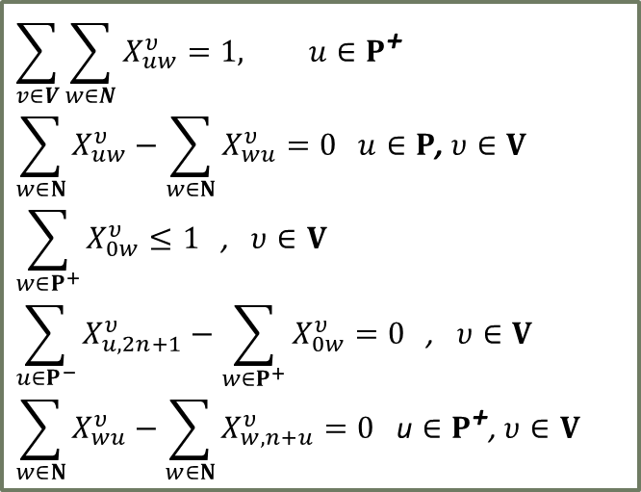

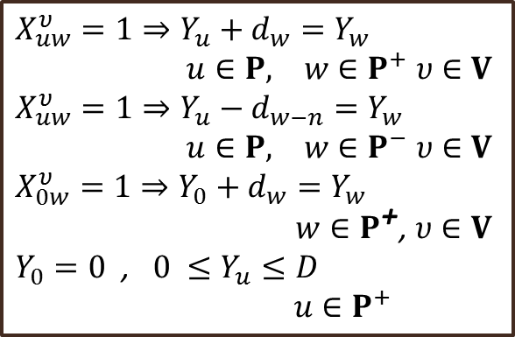
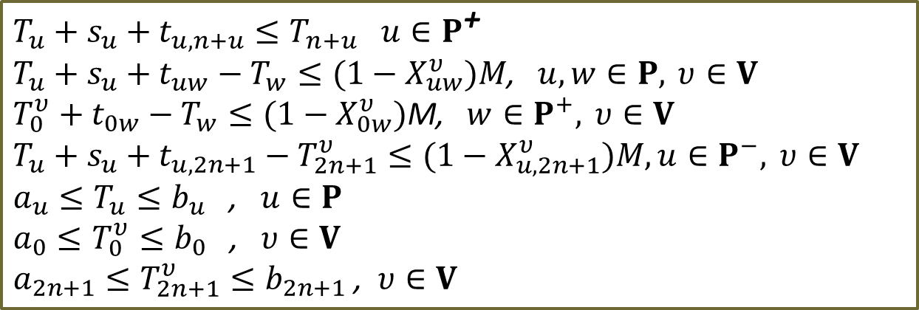
$$Minimize Z=Travel Disutility$$
$$\sum_{v∈V}{\sum_{w∈N}{X_{uw}^{υ}}}=1, u∈P^{\text{+}}$$
$$\sum_{w∈N}{X_{uw}^{υ}}−\sum_{w∈N}{X_{wu}^{υ}}=0 u∈P\text{, }υ∈V$$
$$\sum_{w∈P^{+}}{X_{0w}^{υ}}≤1\text{ , }υ∈V$$
$$\sum_{u∈P^{−}}{X_{u,2n+1}^{υ}}−\sum_{w∈P^{+}}{X_{0w}^{υ}}=0\text{ , }υ∈V$$
$$\sum_{w∈N}{X_{wu}^{υ}}−\sum_{w∈N}{X_{w,n+u}^{υ}}=0 \text{u}∈P^{\text{+}}\text{, }υ∈V$$
$$X_{uw}^{υ}=1⇒Y_{u}+d_{w}=Y_{w}$$
$u∈P, w∈P^{+} υ∈V$
$$X_{uw}^{υ}=1⇒Y_{u}−d_{w−n}=Y_{w}$$
$u∈P, w∈P^{−} υ∈V$
$$X_{0w}^{υ}=1⇒Y_{0}+d_{w}=Y_{w}$$
$w∈P^{\text{+}}\text{, }υ∈V$
$Y_{0}=0\text{ , }0 ≤Y_{u}≤D$
$u∈P^{+}$
Conservation of Flow
Tour Length Constraints
$$T_{u}+s_{u}+t_{u,n+u}≤T_{n+u} u∈P^{\text{+}}$$
$$T_{u}+s_{u}+t_{uw}−T_{w}≤(1−X_{uw}^{υ})M\text{, }u,w∈P, υ∈V$$
$$T_{0}^{υ}+t_{0w}−T_{w}≤(1−X_{0w}^{υ})\text{M}\text{, }w∈P^{+}, υ∈V$$
$$T_{u}+s_{u}+t_{u,2n+1}−T_{2n+1}^{υ}≤(1−X_{u,2n+1}^{υ})M, u∈P^{−}, υ∈V$$
$$a_{u}≤T_{u}≤b_{u}\text{ , }u∈P$$
$$a_{0}≤T_{0}^{υ}≤b_{0}\text{ , }υ∈V$$
$$a_{2n+1}≤T_{2n+1}^{υ}≤b_{2n+1}\text{ , }υ∈V$$
Precedence Constraints
Time windows

Slide 11

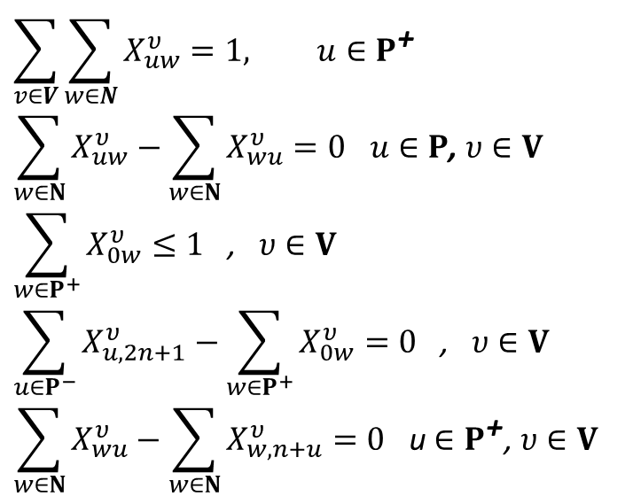

Location Selection Problem for HAPP
Activities with Pre-Selected Locations
$$\sum_{v∈V}{\sum_{w∈N}{X_{uw}^{υ}}}=1, u∈P^{\text{+}}$$
$$\sum_{w∈N}{X_{uw}^{υ}}−\sum_{w∈N}{X_{wu}^{υ}}=0 u∈P\text{, }υ∈V$$
$$\sum_{w∈P^{+}}{X_{0w}^{υ}}≤1\text{ , }υ∈V$$
$$\sum_{u∈P^{−}}{X_{u,2n+1}^{υ}}−\sum_{w∈P^{+}}{X_{0w}^{υ}}=0\text{ , }υ∈V$$
$$\sum_{w∈N}{X_{wu}^{υ}}−\sum_{w∈N}{X_{w,n+u}^{υ}}=0 \text{u}∈P^{\text{+}}\text{, }υ∈V$$
$$\sum_{v∈V}{\sum_{w∈N}{X_{uw}^{υ}}}=1\text{, } \text{u}∈P_{P}^{+}$$
$$\sum_{v∈V}{\sum_{u∈P_{A}^{+}}{\sum_{w∈N}{X_{uw}^{υ}}}}=1,A_{a}∈A$$
Candidate Locations for activity $A_{a}$
Generalized VRP (Ghiani and Improta, 2000)

Slide 12
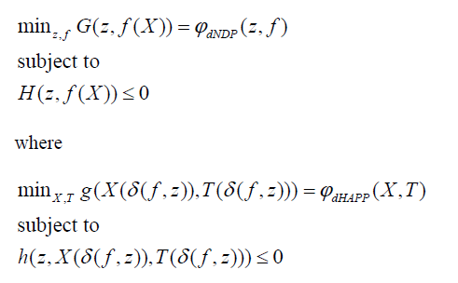
NDP-HAPP Model
Supernetwork approach
  Infrastructure network
  Activity network
Network design decisions
Flow assignment
dNDP
OD Flow
Network Level of Service
Individual HH travel decisions
dHAPP

Slide 13
NDP-HAPP: dNDP
Modified from Unconstrained Multicommodity Formulation
(Magnanti and Wong, 1984)
Each OD pair is treated as one commodity type
Aggregate individual HH itinerary into OD flow

Slide 14
NDP-HAPP: dHAPP
Update Network LOS

Slide 15
NDP-HAPP
Solution Algorithm
Decomposition
  Blocks of decision making rationale
  Location Routing Problems (Perl and Daskin, 1985)
  Iterative Optimization Assignment (Friesz and Harker, 1985)

Slide 16
Illustrative Example
NDP-GHAPP
Grocery Shopping
Start [5,20]
For 1 hr
Return before 22
Node 1, Node 5
Work:
Start [9, 9.5]
For 8 hr
Return before 22
Network
  Objective:
2 HHs: 1 HH member with 1 vehicle
  Objective:
  A(HH1) =
  {work, grocery shopping}
  A(HH2) =
  {work, general shopping}
H1
H2
General Shopping
Start [5,21]
For 1 hr
Return before 22
Node 3, Node 8
Work:
Start [8.5,9]
For 8 hr
Return before 22

Slide 17
Changes in activity sequences, destination choice, departure times
 | Iteration 1 | Iteration 2 | Iteration 3 | Iteration 4
dHAPP1 | Home (0) → grocery shopping (1) → work (2) → home (0) Objective Value: 2 | Home (0) → work (2) → grocery shopping (1) → home (0) Objective Value: 2 | Home (0) → grocery shopping (5) → work (2) → home (0) Objective Value: 4 | Home (0) → grocery shopping (5) → work (2) → home (0) Objective Value: 3
dHAPP2 | Home (5) → work (6) → general shopping (8) → home (5) Objective Value: 3 | Home (5) → work (6) → general shopping (8) → home (5) Objective Value: 3 | Home (5) → work (6) → general shopping (3) → home (5) Objective Value: 4 | Home (5) → work (6) → general shopping (3) → home (5) Objective Value: 4
dNDP | Network Design Decisions: Z01, Z10, Z12, Z21, Z58, Z67, Z76, Z78, Z85, Z87 dNDP objective value: 35 HH1 Paths link Flows: (0) → (1) → (2) → (1) → (0) HH2 Paths link Flows: (5) → (8) → (7) → (6) → (7) → (8) → (5) Update each dHAPP objective values: HH1: 2, HH2: 3 | Network Design Decisions: Z03, Z10, Z21, Z36, Z52, Z67, Z78, Z85 dNDP objective value: 32 HH1 Paths link Flows: (0) → (3) → (6) → (7) → (8) → (5) → (2) → (1) → (0) HH2 Paths link Flows: (5) → (2) → (1) → (0) → (3) → (7) → (8) → (5) Update each dHAPP objective values: HH1: 4, HH2: 4 | Network Design Decisions: Z03, Z10, Z21, Z34, Z36, Z45, Z52, Z63 dNDP objective value: 31 HH1 Paths link Flows: (0) → (3) → (4) → (5) → (2) → (1) → (0) HH2 Paths link Flows: (5) → (2) → (1) → (0) → (3) → (6) → (3) → (4) → (5) Update each dHAPP objective values: HH1: 3, HH2: 4 | NA³
Objective | 40 | 40 | 38 | 38
Changes in network investment decisions
Shortest path, Link flow changes

Slide 18
Illustrative Example
NDP-GHAPP
18:00
17:00
Work
NDP-GHAPP
  Optimal
NDP-HAPP
  5% Optimality gap
Flexibility in dHAPP allows more options to be searched
General shopping
@ Node 3
19:00
18:00
9:00
17:00
8:30
16:30
7:30
Grocery shopping
@ Node 5
6:00
H1
Work
8:30
7:00
H2

Slide 19
Large scale case study
Link improvement decision
  SR39, SR68, SR55, SR55, SR22, SR261, SR 241
dNDP:

Slide 20
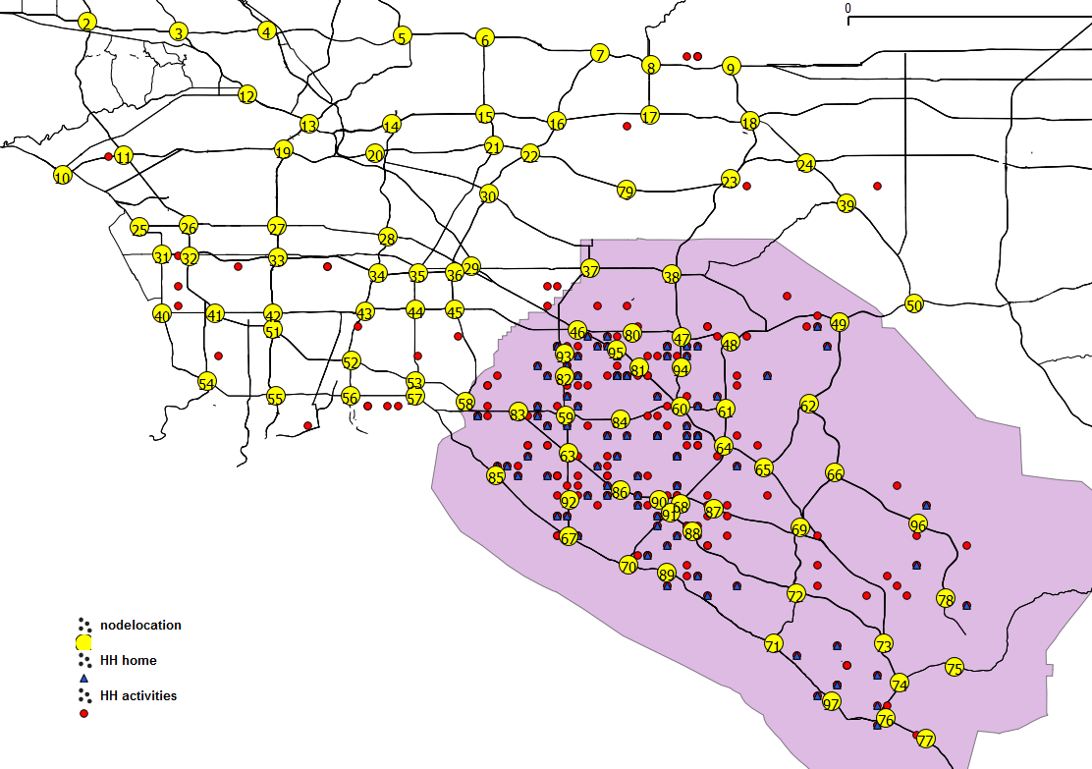

Large scale case study
California Statewide Household Travel Survey
  CalTrans, 2001
  Departure and arrival times, trip/activity durations, geo-coded locations
  60HHs
  HAPP case1: no interaction between HH members
  Time Windows generated similar to Recker and Parimi (1999)
  Individually estimated objective weights (Chow and Recker, 2012)
  dHAPP:

Slide 21
Budget | NDP-HAPP |  |  |  |  |  |  | Conventional NDP
 | # iter | Link Construction Decision | dNDP obj | dHAPP obj | # trips (# intra) | # HHs affected | Time (sec) | Link Construction Decision | NDP obj
Before | NA | NA | 27.02 | 616.49 | 199 (76) | NA | NA | NA | 27.02
1000 | 2 | 8988, 7875, 7578 | 25.99 | 609.58 | 199 (76) | 5/60 | 306 | 8988, 7875, 7578 | 25.99
2000 | 2 | 8988, 7875, 7578, 7937, 8660, 6786, 8887 | 25.30 | 606.51 | 199 (76) | 13/60 | 294 | 8988, 7875, 7578, 7937, 8660, 6786, 8887 | 25.30
3000 | 2 | 8988, 7875, 7578, 7937, 8660, 6786, 8887, 6086, 8667, 8889 | 24.88 | 604.49 | 199 (76) | 14/60 | 326 | 8988, 7875, 7578, 7937, 8660, 6786, 8887, 6086, 8667, 8889 | 24.88
4000 | 1 | 8988, 7875, 7578, 7937, 8660, 6786, 8887, 6086, 8667, 8889, 6162, 6589, 8765, 8788 | 24.79 | 604.12 | 199 (76) | 17/60 | 196 | 8988, 7875, 7578, 7937, 8660, 6786, 8887, 6086, 8667, 8889, 6162, 6589, 8765, 8788 | 24.79
5000 | 1 | 8988, 7875, 7578, 7937, 8660, 6786, 8887, 6086, 8667, 8889, 6162, 6589, 8765, 8788, 6261 | 24.79 | 604.11 | 199 (76) | 17/60 | 191 | 8988, 7875, 7578, 7937, 8660, 6786, 8887, 6086, 8667, 8889, 6162, 6589, 8765, 8788, 6261 | 24.79
No limit | 1 | All | 24.79 | 604.11 | 199 (76) | 17/60 | 215 | All | 24.79

Slide 22
NDP-HAPP Summary
OD is not a priori, subject of responses of individual HH decisions
Bi-level formulation
  Upper level: NDP
  Lower Level: HAPP
  Decomposition algorithm
    Reasonable in accuracy, running time
Incorporated OD changes, TOD changes
Future Research
  More sophisticated network strategies
  Integration of congestion effect: Infrastructure layer
  Demand Capacity: Activity layer

Slide 23
Thank you
Questions or comments? jekang@uci.edu

Slide 24
Illustrative example
NDP-HAPP
Work:
Start [9, 9.5]
For 8 hr
Return before 22
Network
  Objective:
2 HHs: 1 HH member with 1 vehicle
  Objective:
  A(HH1) =
  {work, grocery shopping}
  A(HH2) =
  {work, general shopping}
H1
Grocery Shopping
Start [5,20]
For 1 hr
Return before 22
H2
Work:
Start [8.5,9]
For 8 hr
Return before 22
General Shopping
Start [5,21]
For 1 hr
Return before 22

Slide 25
Illustrative example
NDP-HAPP
 | Iteration 1 | Iteration 2
dHAPP1 | Home (0) → work (2) → grocery shopping (5) → home (0) Objective Value: 3 | Home (0) → work (2) → grocery shopping (5) → home (0) Objective Value: 3
dHAPP2 | Home (5) → work (6) → general shopping (8) → home (5) Objective Value: 3 | Home (5) → work (6) → general shopping (8) → home (5) Objective Value: 3
dNDP | Network Design Decisions: Z01, Z12, Z25, Z30, Z36, Z43, Z54, Z36, Z78, Z85 dNDP objective value: 36 HH1 Paths link Flows: Home (0) → (2) → (5) → (4) → (3) → (0) HH2 Paths link Flows: (5) → (4) → (3) → (6) → (7) → (8) → (5) Update each dHAPP objective values: HH1: 3, HH2: 3 | NA
Final Objective | 42 | 42

Slide 26
Illustrative example
NDP-HAPP
NDP-HAPP
    5% Optimality gap

