Slide 1



A Continuous-Approximation Model to Optimize Common Stations` Density for Skip-Stop Operations
Maxime Freyss, Ricardo Giesen, Juan Carlos Muñoz
Pontificia Universidad Católica de Chile
Department of Transport Engineering and Logistics
ISTTT - July 17, 2013

Slide 2
Outline
Motivation
Skip-stop operations
Single track skip-stop continuous approximation model
Case study and analysis of results
Conclusions

Slide 3
Motivation – February 2007
In 2007, Santiago inaugurated a new fully integrated transit system: TRANSANTIAGO
As a result, Metro saw its demand almost double, damaging the comfort offered severely.
TRANSANTIAGO

Slide 4
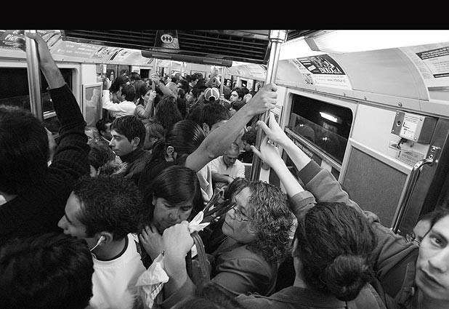
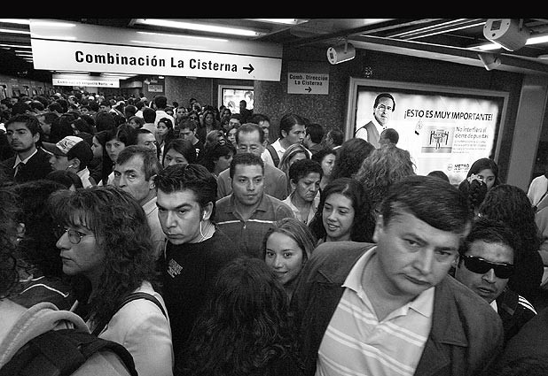
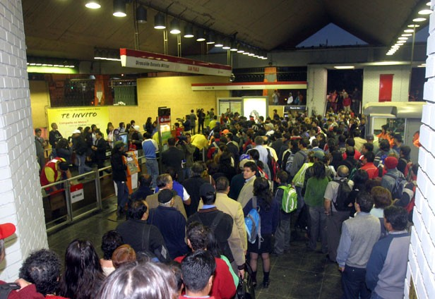
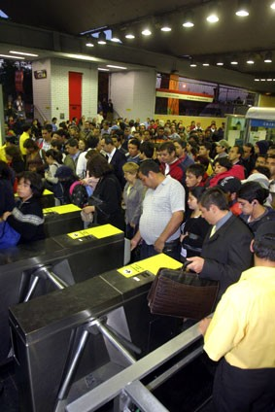

Slide 5
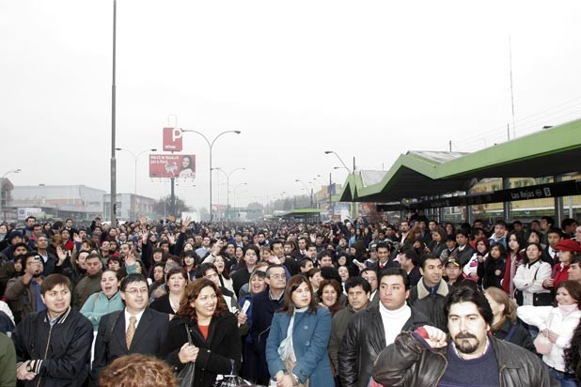

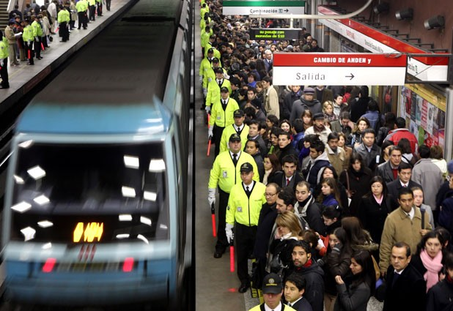

Slide 6
How to increase capacity?
The capacity is given by the capacity of each train and the frequency being offered
Trains could be ordered but take time to arrive
The frequency in a line for a given fleet:
f = n/t_{c}
We needed to reduce cycle times on a network where all lines are single-tracked. Short services had already been implemented….

Slide 7


Slide 8

Skip-stop operation
Skip-Stop Operation
All Stop Operation
35 min
44 min
Common station
Station 2
Station 3
Station 5
Station 6
Station ..
Station 22
Station 1
Red station
Green station
Red station
Green station
Common station
Red station
Green station
Common station
Station 4
Station 7

Slide 9
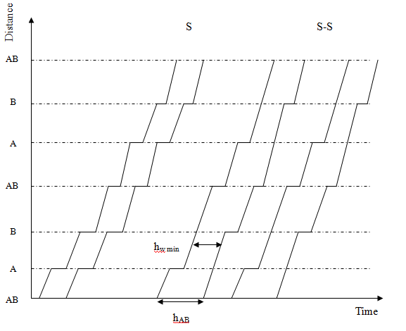
Time-space Diagram

Slide 10
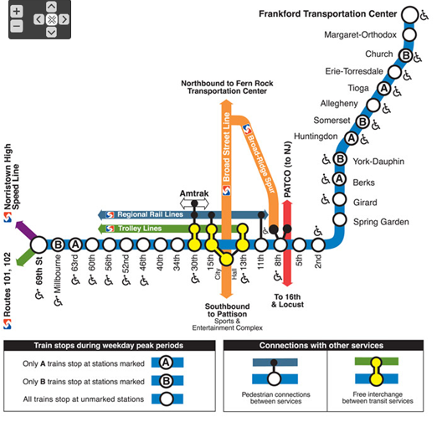
Skip-stop operation
This idea has been implemented before few times.
  Chicago
  Philadelphia
  New York

Slide 11
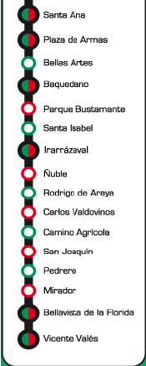
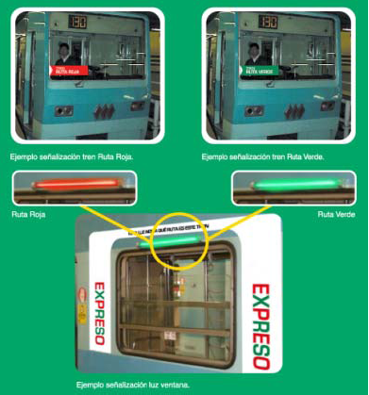
Skip-stop operation: Implementation
Peak hours only
All lines except the most crowded and frequent (Line 1)
: Common stations
: Red stations
: Green Stations

Slide 12
Skip-stop operation: Results
Shorter travel time and lower density
Reduction in energy consumption by the lower number of traction and braking of trains
DENSITY
4 %
6 %
Estimated % energy savings (in regim, all day)
6 %
1 %

Slide 13
Skip-stop operation: Results
Massive approval rate from users
National Innovation Award on the public Sector
But where is the research question here?

Slide 14
Two Research questions
Provide guidelines about skip-stop operations
    When is skip-stop operation worth considering for a subway line given its characteristics (i.e. station locations, given number of trains, value of time, etc.)?
    Give general recommendations about density of common station locations (e.g. one every two, four, six stations?).

Slide 15
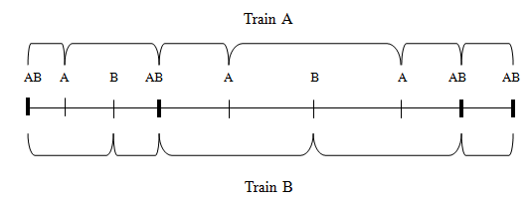
Skip-stop definitions
We consider three types of stations:
  Common stations (AB) in which each train stops
  A & B stations in which half of the trains stop

Slide 16
Continuous Approximation Model
A continuous approximation model is built assuming that local conditions surrounding a station change smoothly over the corridor.
A local function (around a station) of total costs is constructed for each operational strategy (all stop and skip-stop).
Costs are computed on [$/station/hr]

Slide 17
Modeling Assumptions
Trains operate in a double-track circle line of length 2L, with a single track on each direction and without terminals.
Headways between trains are constant.
Maintenance costs are not considered.
No capacity constraints are considered.
Key assumption: All stations are equally likely as destination for any given trip.
Then: The maximum trip length is L and the average trip length is L/2

Slide 18
Model Parameters
Local:
  λ [1/m]: station density in the line
  N: number of passengers starting a trip at a specific station
Global:
  L [m]: Half of total line length
  num_{trains}: Available trains in the fleet for each way
  a [m/s²]: Acceleration and deceleration rate of the subway
  v_{l} [m/s]: Cruising speed of the subway
  t_{s} [s]: Dwell time in every station
  F [N]: Traction force of a train
  VTV [CL$/s]: Social value of the travel time
  VTE [CL$/s]: Social value of the waiting time
  CE [CL$/W.s]: Energy cost
  C_{T} [CL$]: Transfer cost

Slide 19
Single Decision Variable
δ[/km]: Common station density
  (only for skip-stop operation)
We can solve the problem for local conditions surrounding a station and get an optimal δ. This will tell us about optimal common station density around it

Slide 20
All stop service Model
Total costs:
  All stop operation:
  Travel time + Waiting time + Operational costs
  Skip-Stop operation:
  Travel time + Waiting time + transfer time + Operational costs

Slide 21

All stop service Model
Travel Time:
  In motion:
  Stopped:

Slide 22


All stop service Model
Waiting Time:
  Cycle time of a train:
  Average waiting time per pax:

Slide 23
All stop service Model
Operating Costs:
  Traction acceleration phase (very expensive) proportional to the number of stations
  Keep cruising speed between two stops (less expensive) function of the distance between stations

Slide 24
Skip-stop Service Model
We need to distinguish 5 type of trips:
  Type 1: From AB (common) to AB station.

Slide 25
Example: type 1
We need to distinguish 5 type of trips:
  Type 1: From AB (common) to AB station.

Slide 26
Skip-stop Service Model
We need to distinguish 5 type of trips:
  Type 1: From AB (common) to AB station.
  Type 2: From AB station to A (or B) station or vice versa. Some passengers might have to board the second stopping train.

Slide 27
Example: type 2
We need to distinguish 5 type of trips:
  Type 2: From AB station to A (or B) station or vice versa. Some passengers might have to board the second stopping train.

Slide 28
Skip-stop Service Model
We need to distinguish 5 type of trips:
  Type 1: From AB (common) to AB station.
  Type 2: From AB station to A (or B) station or vice versa. Some passengers might have to board the second stopping train.
  Type 3: From A to another A station, or from B to B. Again some passengers might have to board the second passing train.

Slide 29
Example: type 3
We need to distinguish 5 type of trips:
  Type 3: From A to another A station, or from B to B. Again some passengers might have to board the second passing train.

Slide 30
Skip-stop Service Model
We need to distinguish 5 type of trips:
  Type 1: From AB (common) to AB station.
  Type 2: From AB station to A (or B) station or vice versa. Some passengers might have to board the second stopping train.
  Type 3: From A to another A station, or from B to B. Again some passengers might have to board the second passing train.
  Type 4: From A station to a B station with a common (AB) station in between, or vice versa.

Slide 31
Example: type 4
We need to distinguish 5 type of trips:
  Type 4: From A station to a B station with a common (AB) station in between, or vice versa.

Slide 32
Skip-stop Service Model
We need to distinguish 5 type of trips:
  Type 1: From AB (common) to AB station.
  Type 2: From AB station to A (or B) station or vice versa. Some passengers might have to board the second stopping train.
  Type 3: From A to another A station, or from B to B. Again some passengers might have to board the second passing train.
  Type 4: From A station to a B station with a common (AB) station in between, or vice versa.
  Type 5: From an A to a B station without a common (AB) station in between. Passengers need to travel on the opposite direction of their destination on some leg.

Slide 33
Example: type 5
We need to distinguish 5 type of trips:
  Type 5: From an A to a B station without a common (AB) station in between. Passengers need to travel on the opposite direction of their destination on some leg.

Slide 34




Skip-stop Service Model
Since there are λL stations; δL common (AB) stations, and A and B stations, then the fractions of each type of trip are:

Slide 35



Skip-stop Service Model
For types 4 and 5, the probability of trips longer than the distance to a common station is:
Then:

Slide 36
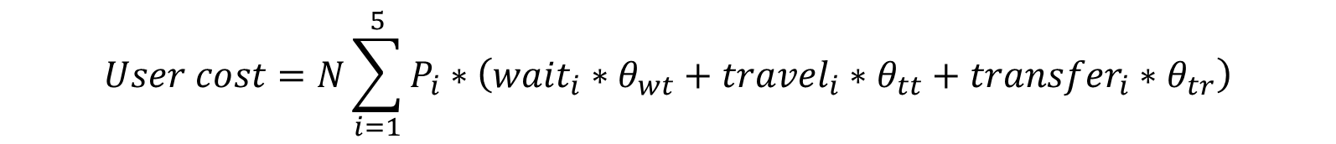
Skip-stop Service Model
Travel time for each type can be computed based on the number of stops as a function of λ and δ for each trip type.
$$User cost=N\sum_{i=1}^{5}{P_{i}∗\left({wait}_{i}∗θ_{wt}+{travel}_{i}∗θ_{tt}+{transfer}_{i}∗θ_{tr}\right)}$$

Slide 37
Skip-stop Service Model
Travel Costs, waiting costs and operational Costs: Similar to all-stops service, but with different number of stops and effective frequencies per trip type.
Transfer Costs for trips type 4 and 5. An additional penalty was considered for trips type 5, since the traveler need to change platform (and direction)

Slide 38
Case Study
Since we could not find an analytical expression for the optimal density of common stations on skip-stop operations
A numerical analysis was performed, and assuming typical values for the system parameters

Slide 39
Case Study
L=10.000m = 10 Km
fleet=25 trains
N=5000 pax/hr
λ=1 station every 500 meters

Slide 40
Analysis of results
Effect of each variable on the objective function
Sensitivity analysis of global parameters
Sensitivity analysis of local parameters

Slide 41
Effect of different parameters in the Objective Function
Waiting times decrease when δ increases
Transfer costs decrease when δ increases
Travel time decrease and then increase with δ
Operational costs increase when δ increases

Slide 42
Effect of each term on the objective function

Slide 43
Sensitivity analysis on fleet size
Skip-stop operations are less convenient with lower frequencies
Examples: regional trains, off-peak periods
Optimal density is robust to changes in station density

Slide 44
Sensitivity analysis on line (trip) length
Gains are higher when L is longer
Optimal density is smaller
Thus, skip-stop operations are more convenient when trips are longer.

Slide 45
Sensitivity analysis on value of time
The optimal density of common stations varies only a little

Slide 46
Sensitivity analysis on the volume of passengers
For Chilean value of time or higher, pax volumes have small influence
For smaller values of time is more relevant

Slide 47
Sensitivity analysis on density of existing stations
Skip-stop is more convenient when station density is high

Slide 48
Conclusions
The model identifies skip-stop operation attractiveness given easily accessible information
Skip-stop operations are not advisable for systems with: low frequency, low average trip length, or low density of stations.
The proposed model can be used to find the optimal density of common stations.
The optimal density of common stations is quite stable with respect to the parameters studied.

Slide 49
Conclusions/Observations
Skip-Stop can reduce social costs significantly
It can also increase capacity improving comfort
Demand in the corridor adapts to skip-stop operations; transferring trips drop significantly
Implement first the less busy direction only

Slide 50
A Continuous-Approximation Model to Optimize Common Stations` Density for Skip-Stop Operations
Maxime Freyss, Ricardo Giesen, Juan Carlos Muñoz
Pontificia Universidad Católica de Chile
Department of Transport Engineering and Logistics
ISTTT - July 17, 2013

Slide 51
Benefits of increased travel speed
Operational alternatives
Benefits
Reduce operating costs
Reduce number of vehicles
Increase profits or reduce subsidies
Reduce cycle times
Reduce Travel times
Reduce headways
Reduce Waiting times
Increase in modal share (pax diverted from automobile)
Increase capacity
Improve comfort

Slide 52
Análisis de sensibilidad (evaluación social)
De nuevo, el óptimo es muy estable
Sin embargo impacta la segunda parte de las curvas
Por eso ayuda a entender que lo que realmente define el óptimo es el tiempo de viaje (ver siguiente)

Slide 53
Influencia de la variable en la FO
Tiempo de viaje:

Slide 54


Skip-stop Service Model
Waiting Time: Similar to all stop but with different cycle time:
Trip type 1:
Ese tiempo representa la « unidad temporal »

Slide 55
Modelación del servicio expreso
Or
Trenes A
Trenes B
Posición temporal del pasajero
1 Unidad de tiempo
Types 2 and 3:
Promedio: 2 « unidades » de espera
1
2
1

Slide 56
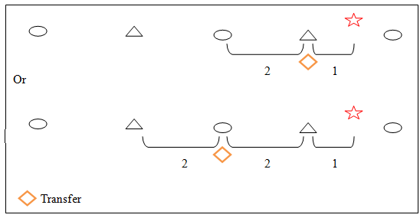
Modelación del servicio expreso
Tipos 4 y 5:
Promedio: 4 « unidades » de espera

Slide 57
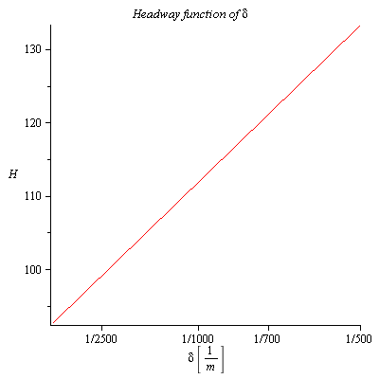
Aparte sobre los headways
Se tiene que ajustar la flota en función del largo de la línea para que la frecuencia:
  No sea demasiado baja (los tiempos de espera subirían mucho)
  No sea demasiado alta para respetar el mínimo técnico headway (no tiene que superar 90 segundos)

Slide 58
Contenidos
Contexto y Motivación
Funcionamiento de servicio expreso
Modelación de una línea ferroviaria
Análisis de resultados
Relajación de los supuestos
Conclusiones

Slide 59
Base del trabajo
El operador debe elegir entre aumentar frecuencia (con la misma flota) y reducir la flota
Lo que se hace en Santiago hoy día: aumentar frecuencia
El punto de vista es más « social ». Se eligió trabajar con ese.

Slide 60
Contenidos
Contexto y Motivación
Funcionamiento de servicio expreso
Modelación de una línea ferroviaria
Análisis de resultados
Relajación de los supuestos
Conclusiones

Slide 61
« Cada estación es equiprobable »
Situación real e impactos:
  Función de distribución de largos de viaje
  Viajes muy cortos (tipo 5) muy pocos probables en realidad
  Supuesto castiga mucho skip-stop
Como se podría resolver:
  Considerar la función de distribución de verdad
  Encontrar los P_{i} con simulación

Slide 62
« No hay problemas de capacidad »
Situación real e impactos:
  Hay estaciones donde todos los pasajeros no pueden subirse al primer tren que llega
  Implica un gran costo en tiempo de espera adicional
  El modelo tendría que indicar que las estaciones AB sean las con mayor demanda
Como se podría resolver:
  Considerar capacidad con procesos de llegada de los pasajeros a las estaciones y tomar en cuenta los niveles de ocupación de los trenes

