Slide 1


Boundedly Rational
User Equilibria (BRUE):
Mathematical Formulation and Solution Sets
Xuan Diª, Henry X. Liuª, Jong-Shi Pang^{b}, Xuegang (Jeff) Ban^{c}
ªUniversity of Minnesota, Twin Cities
^{b}University of Illinois at Urbana-Champaign
^{c}Rensselaer Polytechnic Institute
20th International Symposium on
Transportation & Traffic Theory
Noordwijk, the Netherlands
July 17-July 19, 2013

Slide 2
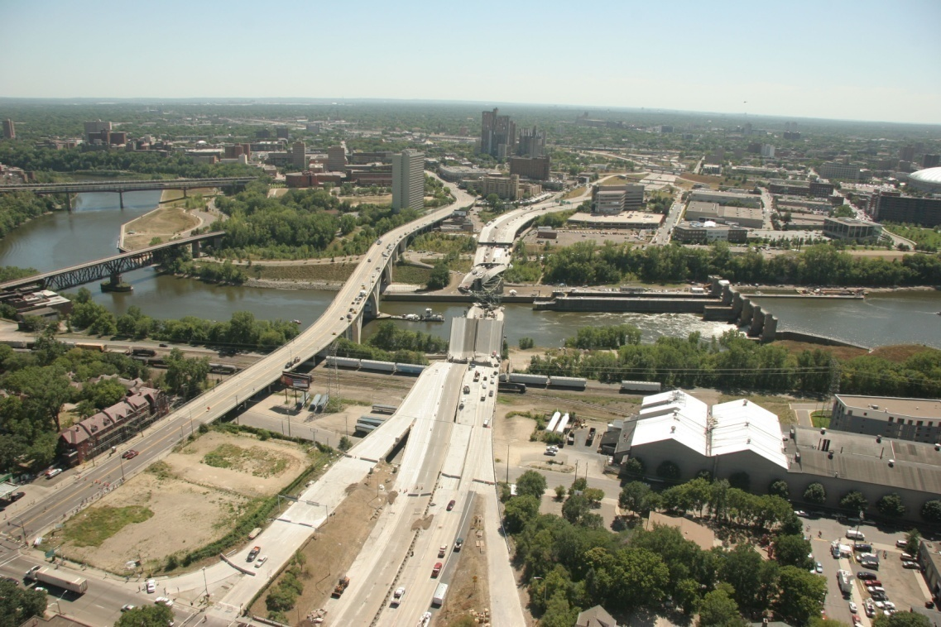
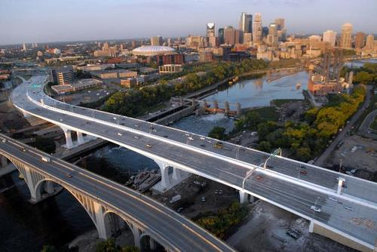
The Fall and Rise
Aug. 1, 2007
Sept. 18, 2008
Source: www.dot.state.mn.us
Notes:
Our study is largely motivated by the fall and rise of the I-35W bridge. On Aug. 1, 2007, the bridge collapsed, and on Sept 18, 2008 the bridge was reopened with a cost of $250m. Here is Minneapolis downtown, and my office is roughly here, 10 minutes walk from the bridge site.
Tragic event, 13 dead, but give us a perfect opportunity to study the traffic equilibration process.

Slide 3
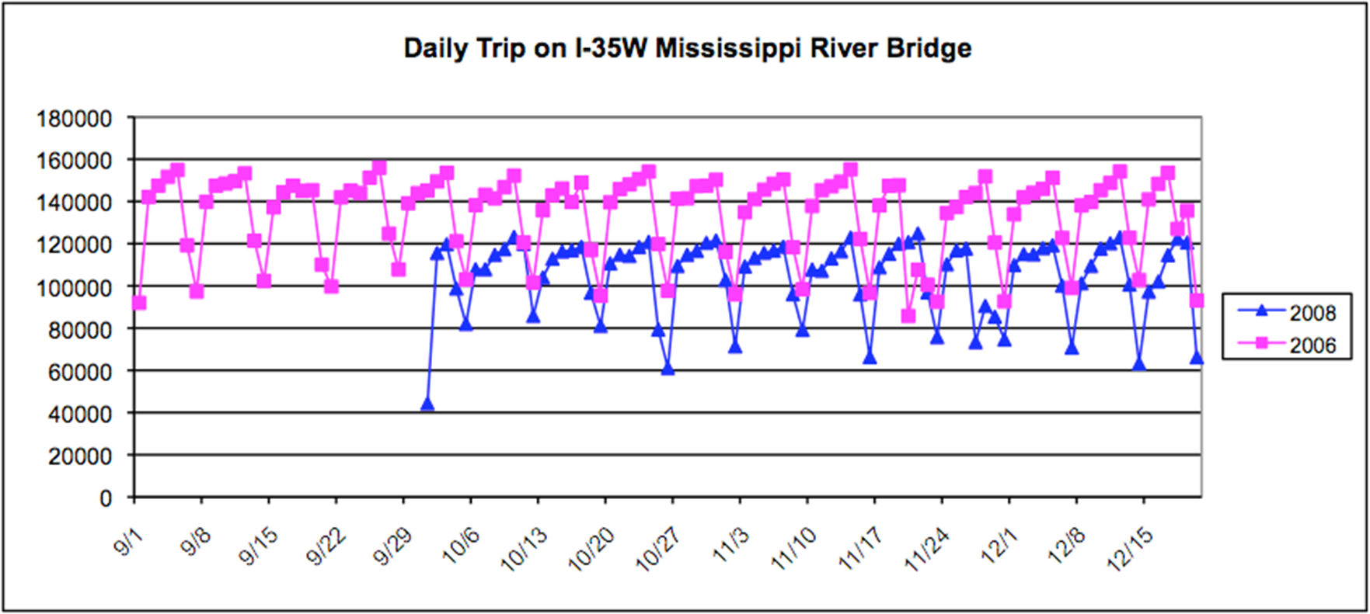
Irreversible Network Change
(Guo and Liu, 2011)
20000!

Slide 4
Boundedly Rational
Route Choice Behavior
Choose a “satisfactory” route instead of an “optimal” route
Travelers are reluctant to change routes if travel time saving is little

Slide 5
Literature on Bounded Rationality
1957 Simon
1996 Conlisk
Psychology & Economics
Transportation Science
Lack of accurate information
Cognitive limitation & Deliberation cost
Heuristics
1987 Mahmassani et al.
2005 Nakayama et al.
2005 Bogers et al.
2006 Szeto et al.
2010 Fonzone et al.

Slide 6
Boundedly Rational User Equilibria (BRUE)
Indifference Band ε
Largest deviation of the satisfactory path from the optimal path
The greater ε, the less rational

Slide 7
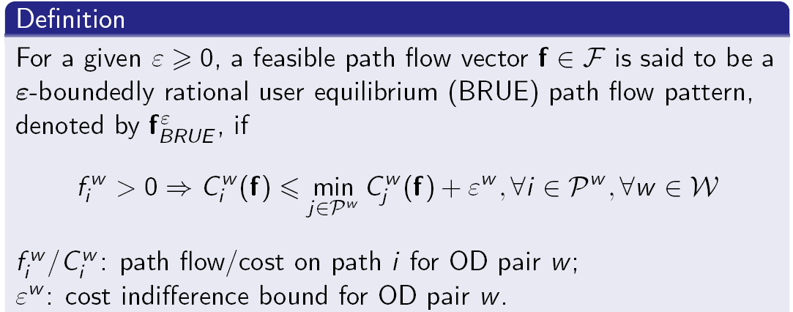
ε-BRUE definition
0

Slide 8
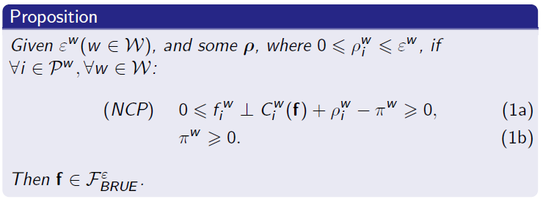

Nonlinear Complementarity Problem (BRUE NCP)
f_{i}>0 C_{i} (f)=π-ρ_{i}≤C_{min}+Ɛ
f_{i}=0 C_{i} (f)≥π-ρ_{i} ≥C_{min}
π=min C(f)+Ɛ, the cost of the longest path carrying flows
Unutilized path cost can be smaller than utilized path cost

Slide 9
UE
BRUE: Ɛ=2
2
1
3
3
2
2
0
1
5
5
8
0
8
0
0.5
3
Longer paths may be used!
2
1.5
5
8
0
BRUE flow not unique!

Slide 10
Constructing BRUE flow set
Non-convexity (Lou et al., 2010)
Worst flow pattern (maximum system travel time)
Assumptions:
Fixed demand
Continuous cost function

Slide 11
Ɛ=0
Ɛ=2
3
3
5
5
8
8
P_{UE}={1}
P^{Ɛ=2}={1,2}
Ɛ=5
P^{Ɛ=5}
3
_{P}^{Ɛ=2}
5
P={1,2,3}
P_{UE}
1
8
3
2
P^{Ɛ=5}={1,2,3}

Slide 12
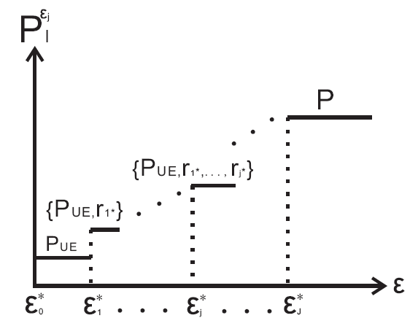
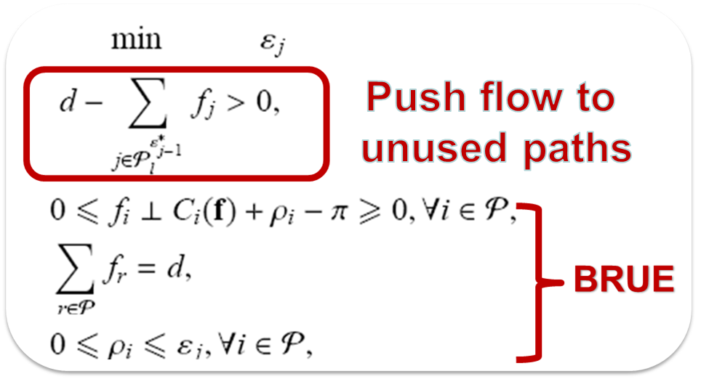
Monotonic Utilized Path Sets
P_{UE}
P
_{P}^{Ɛ}_{J} r_{J}
...
_{P}^{Ɛ}₁ r₁
P_{UE}
P^{Ɛ}₁
Ɛ_{1 ,} f_{1,} r_{1,} P^{Ɛ}₁={P_{UE,} r₁}
Ɛ_{2 ,} f_{2,} r_{2,} P^{Ɛ}₂={P^{Ɛ}_{1,} r₂}
Ɛ*_{j}: minimum s.t. a new path utilized
Notes:
Assume \eps is given. Let’s start from \eps=0. Monotonic relationship

Slide 13
Ɛ*₀= 0
Ɛ*₁= 6
ε
0
{1,2,4}
{1,2,3,4}
15
UE=[2 2 0 2]
ε=15

Slide 14
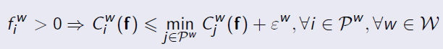
Assigning Flows Among Acceptable Path Sets

Slide 15
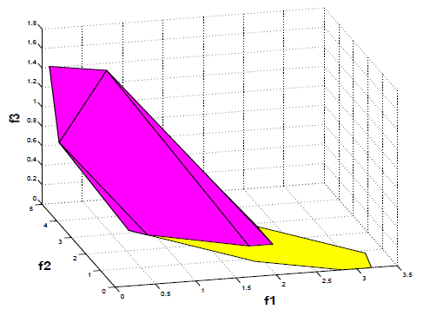
F_{BRUE}= F₀ U F₁
P^{Ɛ*}₁={1, 2, 3, 4}
P^{Ɛ*}₀={1, 2, 4}

Slide 16
Conclusions
Bounded rationality in route choices: indifference band
BRUE NCP
Construction of utilized path sets
Construction of BRUE flow set:
Union of convex subsets given linear cost functions

Slide 17
Future Research Directions
BRUE link flow set
BR network design problem (BR NDP)

Slide 18

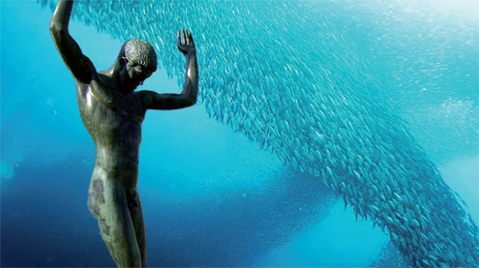
Thank you!
Questions?

